Slide 2
Get Ready For Regionals 2025

Slide 3
Agenda
Competition 101 (20 minutes)
When is it?
How does it work?
Impact Challenges
Challenge Reports
Judging Criteria
Preparation Tips and Checklists
Awards and Recognition
Fire side chat with Enactus Canada Alumna, Danielle Walker (30 minutes)
General Q&A (10 minutes)

Slide 4
Enactus Canada Regional Exposition

Slide 5
Reminder
Individual Registration Deadlines*:
Registration in English | Inscription en Français
Atlantic: February 11th, 2025 Central: February 11th, 2025 Western: February 11th, 2025
*Everyone attending the exposition from your team must EACH register by these dates. This includes students, faculty, administration and guests/observers.*

Slide 6
Itinerary – Day One
Atlantic Regional Exposition: February 27 – February 28
Central Regional Exposition: March 5-6
Western Regional Exposition: March 13-14
9:00am – 5:15pm: Registration 9:30am – 2:30pm: Regional Leadership Summit (By Invitation Only)
Atlantic/Western: 3:00pm – 4:00pm // Central 2:30pm – 3:00pm: Student Leader Meeting
Atlantic/Western: 3:30pm – 4:30pm // Central 4:00pm – 5:00pm: Faculty Advisor Meeting
Atlantic/Western: 4:00pm – 4:30pm // Central 3:00pm – 3:30pm: Final Reporting Workshop
Atlantic/Western: 5:00pm – 6:00pm // Central 5:30pm – 6:30pm: Opening Ceremony
FYI: Western a Prayer Room will be open from 5:00am to 10:00pm
*timings are subject to change

Slide 7
Itinerary – Day Two
Atlantic Regional Exposition: February 27 – February 28
Central Regional Exposition: March 5-6
Western Regional Exposition: March 13-14
6:30am – 5:15pm: Registration 7:30am – 9:00am: Impact Challenges Team Tech Checks 9:30am – 12:00pm: Desjardins Youth Empowerment Challenge Regional Round of Competition Proudly presented by Desjardins 9:30am – 12:00pm: TD Entrepreneurship Challenge Regional Round of Competition Proudly presented by TD Bank Group 1:00pm – 3:30pm: Canadian Tire Environmental Sustainability Challenge Regional Round of Competition Proudly presented by Canadian Tire Corporation 1:00pm – 3:30pm: Innovation and Impact Challenge Regional Round of Competition Powered by Enactus Alumni 3:15pm – 5:00pm: "The Circle" - Career Connections and Community Showcase (Atlantic + Central) 5:00pm – 6:00pm: Awards Ceremony (4:30pm-5:30pm Western)
*timings are subject to change

Slide 8
Impact Challenges
Morning Presentations: 9:30am – 12:00pm
TD Entrepreneurship Challenge | Desjardins Youth Empowerment Challenge
Afternoon Presentations: 1:00pm – 3:30pm
Canadian Tire Environmental Sustainability Challenge | Innovation and Impact Challenge, powered by Enactus Alumni
Detailed overviews, judging criteria and challenge reports can all be found on our Impact Challenges page on our website!

Slide 9
Regional Exposition
Regionals
4 Impact Challenges
Innovation and Impact Challenge
Desjardins Youth Empowerment Challenge
TD Entrepreneurship Challenge
Canadian Tire Environmental Sustainability Challenge

Slide 10
Competition Pathway
Impact Challenge
Final Rounds
Regional Exposition
Impact
Challenges
National Exposition
Enactus Canada National Champion
World Cup
Enactus Canada
National Competition

Slide 11
Impact Challenges
Each competing team will have a 12-minute time block for their live presentation.
3-minute set-up period
Teams must bring their own projectors and Challenge Reports
5-minute live presentation
4-minute Q&A
Unused presentation time will not be added to your Q&A period
NEW: Logo hold slide (you will add to slide/video) to be shown during set-up & Q&A period for each challenge
Impact Challenge Overviews and Challenge Report templates are available on our website

Slide 13
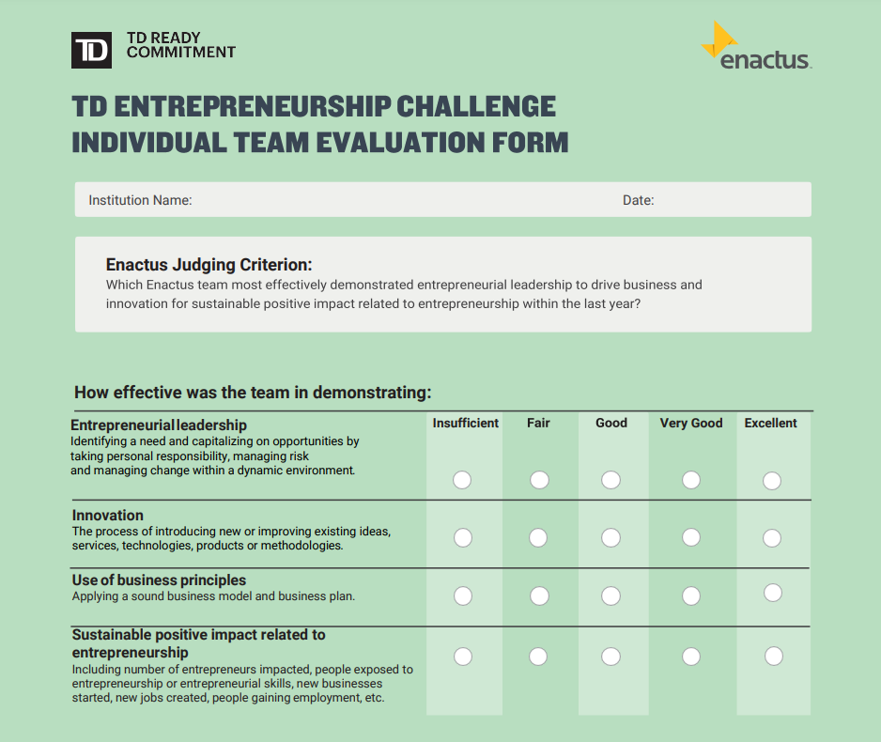
Judging Criteria

Slide 14
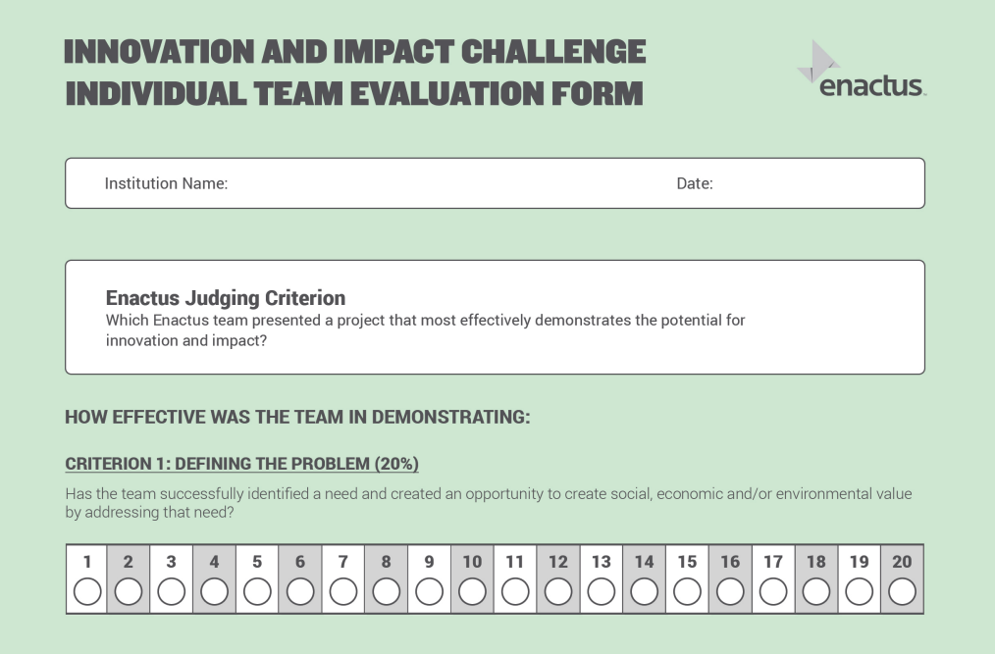
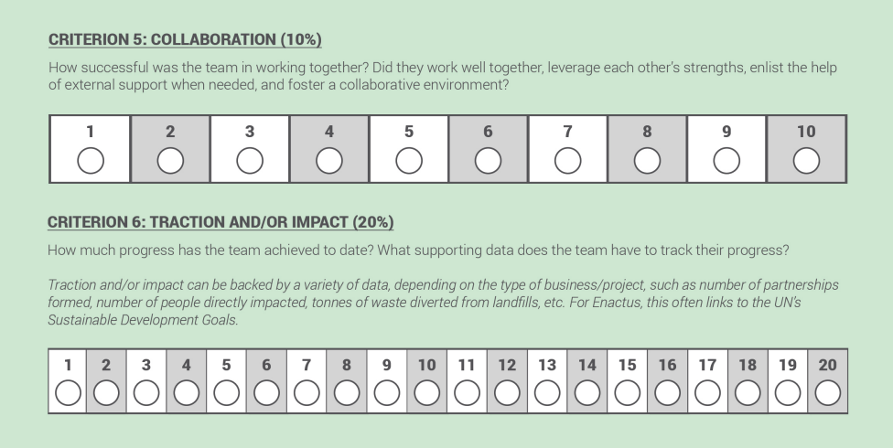
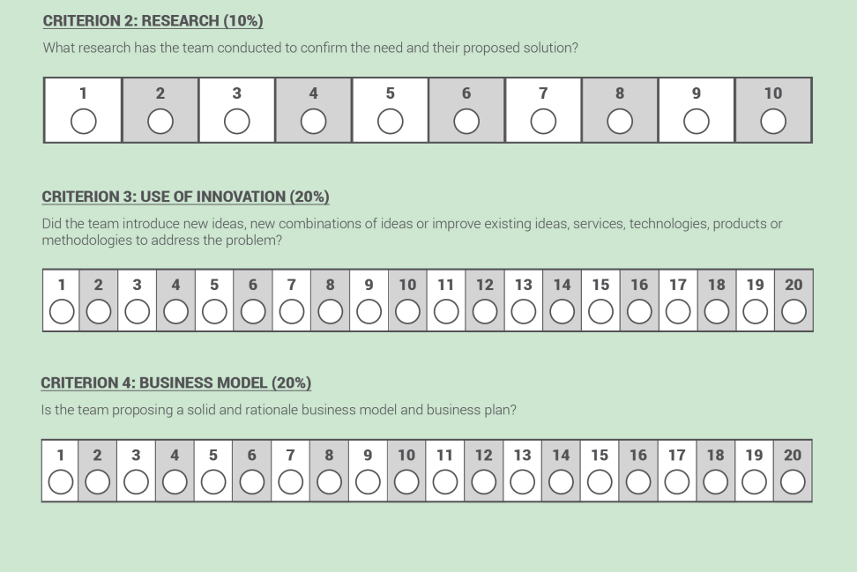
Judging Criteria
Check out all 4 judging criteria here

Slide 15
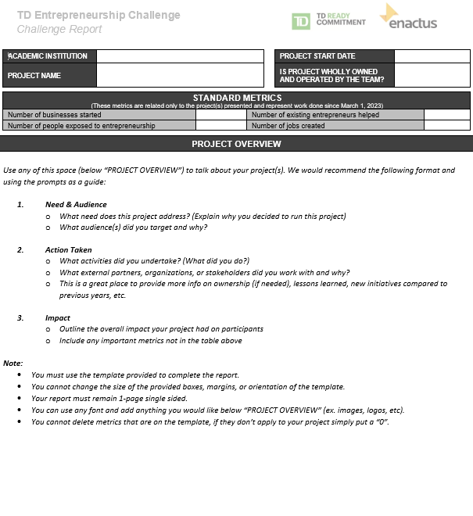
Challenge Reports
All Challenge Reports can be found here

Slide 16
Creating an Effective Challenge Report
Clear & Concise Messaging:
Craft a brief and focused message that clearly communicates your project's purpose, impact and significance.
Impact Metrics at a Glance:
Use key metrics and visuals to showcase the impact in a way that is easily digestible
Storytelling:
Incorporate compelling stories to humanize your project. Share real-life examples and testimonials that convey the tangible impact on individuals or communities.
Addressing Technical Complexity:
If your project involves technical products or services, provide a simplified overview that focuses on the practical benefits rather than technical details.
Three Key Takeaways:
Ensure judges can quickly grasp three key takeaways from your challenge report. This helps them focus on the most critical aspects during their limited review time.

Slide 17
Crafting an Engaging Live Presentation
Start with a Strong Hook:
Capture the judges' attention from the beginning with a compelling opening. This could be a relevant statistic, a thought-provoking question or a brief anecdote related to your project.
Use a Structured Approach:
Organize your presentation with a clear structure. Start with an introduction, followed by the problem statement, your solution, impact and a strong conclusion. Be clear, and concise!
Tell a Story:
Weave a narrative throughout your presentation. Share stories, anecdotes, or testimonials to humanize your project and make it more relatable.
Limit Text on Slides:
Avoid overwhelming slides with too much text. Use bullet points, short sentences and visuals to convey key information. Slides should support your spoken words, not replace them.

Slide 18
Most Importantly…
Practice, Practice, Practice:
Rehearse your presentation multiple times to ensure smooth delivery and confidence. Practice in front of teammates and gather feedback to refine your content and delivery.
Solicit Feedback:
Seek feedback from friends, family, professors, etc. External perspectives can provide valuable insights into areas for improvement.
Remember, this is the first time the judges hear about your project!

Slide 19
Navigating Questions with Ease
Tips and best practices for handling Q&A:
Stay Calm and Composed, even when faced with challenging questions.
Active Listening:
Pay close attention to each question, EVERYONE nodding and maintaining eye contact.
Bridge to Key Messages:
Skillfully bridge questions back to key messages in your project.
Collaborative Answering:
Assign questions based on team members' expertise to provide well-rounded responses.
Be Concise:
Provide concise and to-the-point answers, you only have 4-minutes!!!
Pause for a second before answering!
Gives you and the judges a moment to process and ensures you’re answering what was asked. Your response doesn’t just help the judge who asked, it helps all the judges in their evaluation.

Slide 20
Navigating Questions with Ease
Things to AVOID during the Q&A:
Cutting Judges Off Mid-Question! Even if you think you know where they’re going, interrupting can come off as dismissive. Let them finish, you might catch important details you would’ve missed.
Rambling: Keep it clear and to the point. Over-explaining can make judges lose focus, so answer what’s asked, then stop.
Deflecting Tough Questions: Tackle it directly with confidence. If you don’t have a perfect answer, acknowledge it and pivot: “That’s something we’re exploring, but here’s what we do know...”.
Getting Defensive or Argumentative: Judges may challenge feasibility or impact—it’s not criticism, it’s a chance to showcase your reasoning. Acknowledge their perspective before responding: “That’s a fair point and we considered that during our research. Here’s why we chose this approach…”

Slide 21
Other Prep Tips
Script Writing
Look at the Challenge Report/Judging Criteria and use that as a framework
Needs & Audience
Action Taken
Impact
Next Steps
Make sure to include your metrics in the Impact section
Use the verbiage given in the overview and Challenge Report within your script
Don't add fluff pieces (unnecessary lines that take up time)
Don’t use jargon

Slide 22
Script Writing Tips
Script Writing
Understand the judging criterion: Make the presentation easy for judges to follow
Know the expectations of the judges
Focus on outcomes, but explain your methods
Simplify things: Make your presentation clear and memorable
Be clear about partnerships
Metric timelines: Impact being presented on must have been made between February 28, 2024, and February 27th, 2025
Tell a story!

Slide 23
Preparation Tips
Challenge Report
Enactus reporting should be focused on quality and depth of impact, outcomes and reach
Do not attempt to pack every space with words: less is more
1- Page maximum
Think about the Challenge Report and presentation as one cohesive package
Presentation
Keep it simple and easy to follow along
Use testimonials and get footage of your team running your project!
Need help? Check out the tech presentation strategies document and our video on how to create an Enactus presentation on PowerPoint!
General
Create a workback plan! Work backwards and see what need to get done and when.

Slide 24
Screen
Presenter
Presenter
Presenter
Judges
Tech
Judges
Reserved seating for the presenting team's faculty and students
Spectators
Spectators
Seating is limited and is filled on a first come, first serve basis. Make sure to come early if you want to watch a presentation! Doors cannot be opened once presentations have started

Slide 25
Regionals Checklist
To be submitted prior to attending your respective Regional Expositions:
Project Verification Form – To be submitted electronically via the link provided when completing your Team Registration. This must be signed by Student Leader, Faculty Advisor, and Institutional Administration!
1 digital copy of each of your Challenge Reports via R&R platform here
To be submitted at the Registration Desk prior to Opening Ceremony:
1 printed copy of the Challenge Report for EACH Impact Challenge you are competing in
* All Challenge Reports can be found here:
For presentations:
A projector (if you don't have one or the one you brought is not working, speak with other teams in your league and see if you can borrow theirs!)
A laptop (bring an extra laptop as a backup!)
All necessary cables and adaptors to connect your laptop to your projector
Speakers (if needed)
13 printed copies of the challenge reports for EACH Impact Challenge your team is competing in
A USB stick/hard drive with live audio/visual presentation
* Teams must bring their own AV equipment. Only items provided for you in your presentation rooms are: a screen + a connected power bar, and there won't be any clickers provided.

Slide 26
Regionals Checklist
Attend Opening Ceremonies. Arrive 15 minutes earlier with your team and show your spirit!
Student Leader to attend the Student Leader, Regional Leadership Summit, and Final Reporting workshop
Watch other team presentations
Attend The Circle
Attend Closing Ceremonies
Bring your Spirit!

Slide 27
Awards And Recognition Opportunities

Slide 28
Awards
Recognize the hardworking students and faculty on your Enactus team!
Nominations are to be submitted online via R&R Platform by March 28th!
Check out the Enactus Canada Awards & Recognition Handbook!

Slide 29
Let’s Welcome Enactus Alumna, Danielle Walker!
Notes:
Danielle Walker is an accomplished Enactus alumna from Okanagan College, having represented Canada on the global stage at the 2022 Enactus World Cup in Puerto Rico. She has competed at the regional, national, and international levels, earning recognition for her leadership and impact. Danielle was named the 2022 Enactus Student Leader of the Year, received the 2022 Lieutenant Governor Medal for Inclusion, Democracy, and Reconciliation, and was honoured as the 2024 Enactus Alumni of the Year. Currently, she is a Senior Accountant at Doane Grant Thornton and remains deeply engaged in her community, continuing to drive social impact and foster social entrepreneurship.

