Slide 1

Notes:
Maddie to start it off

Slide 2

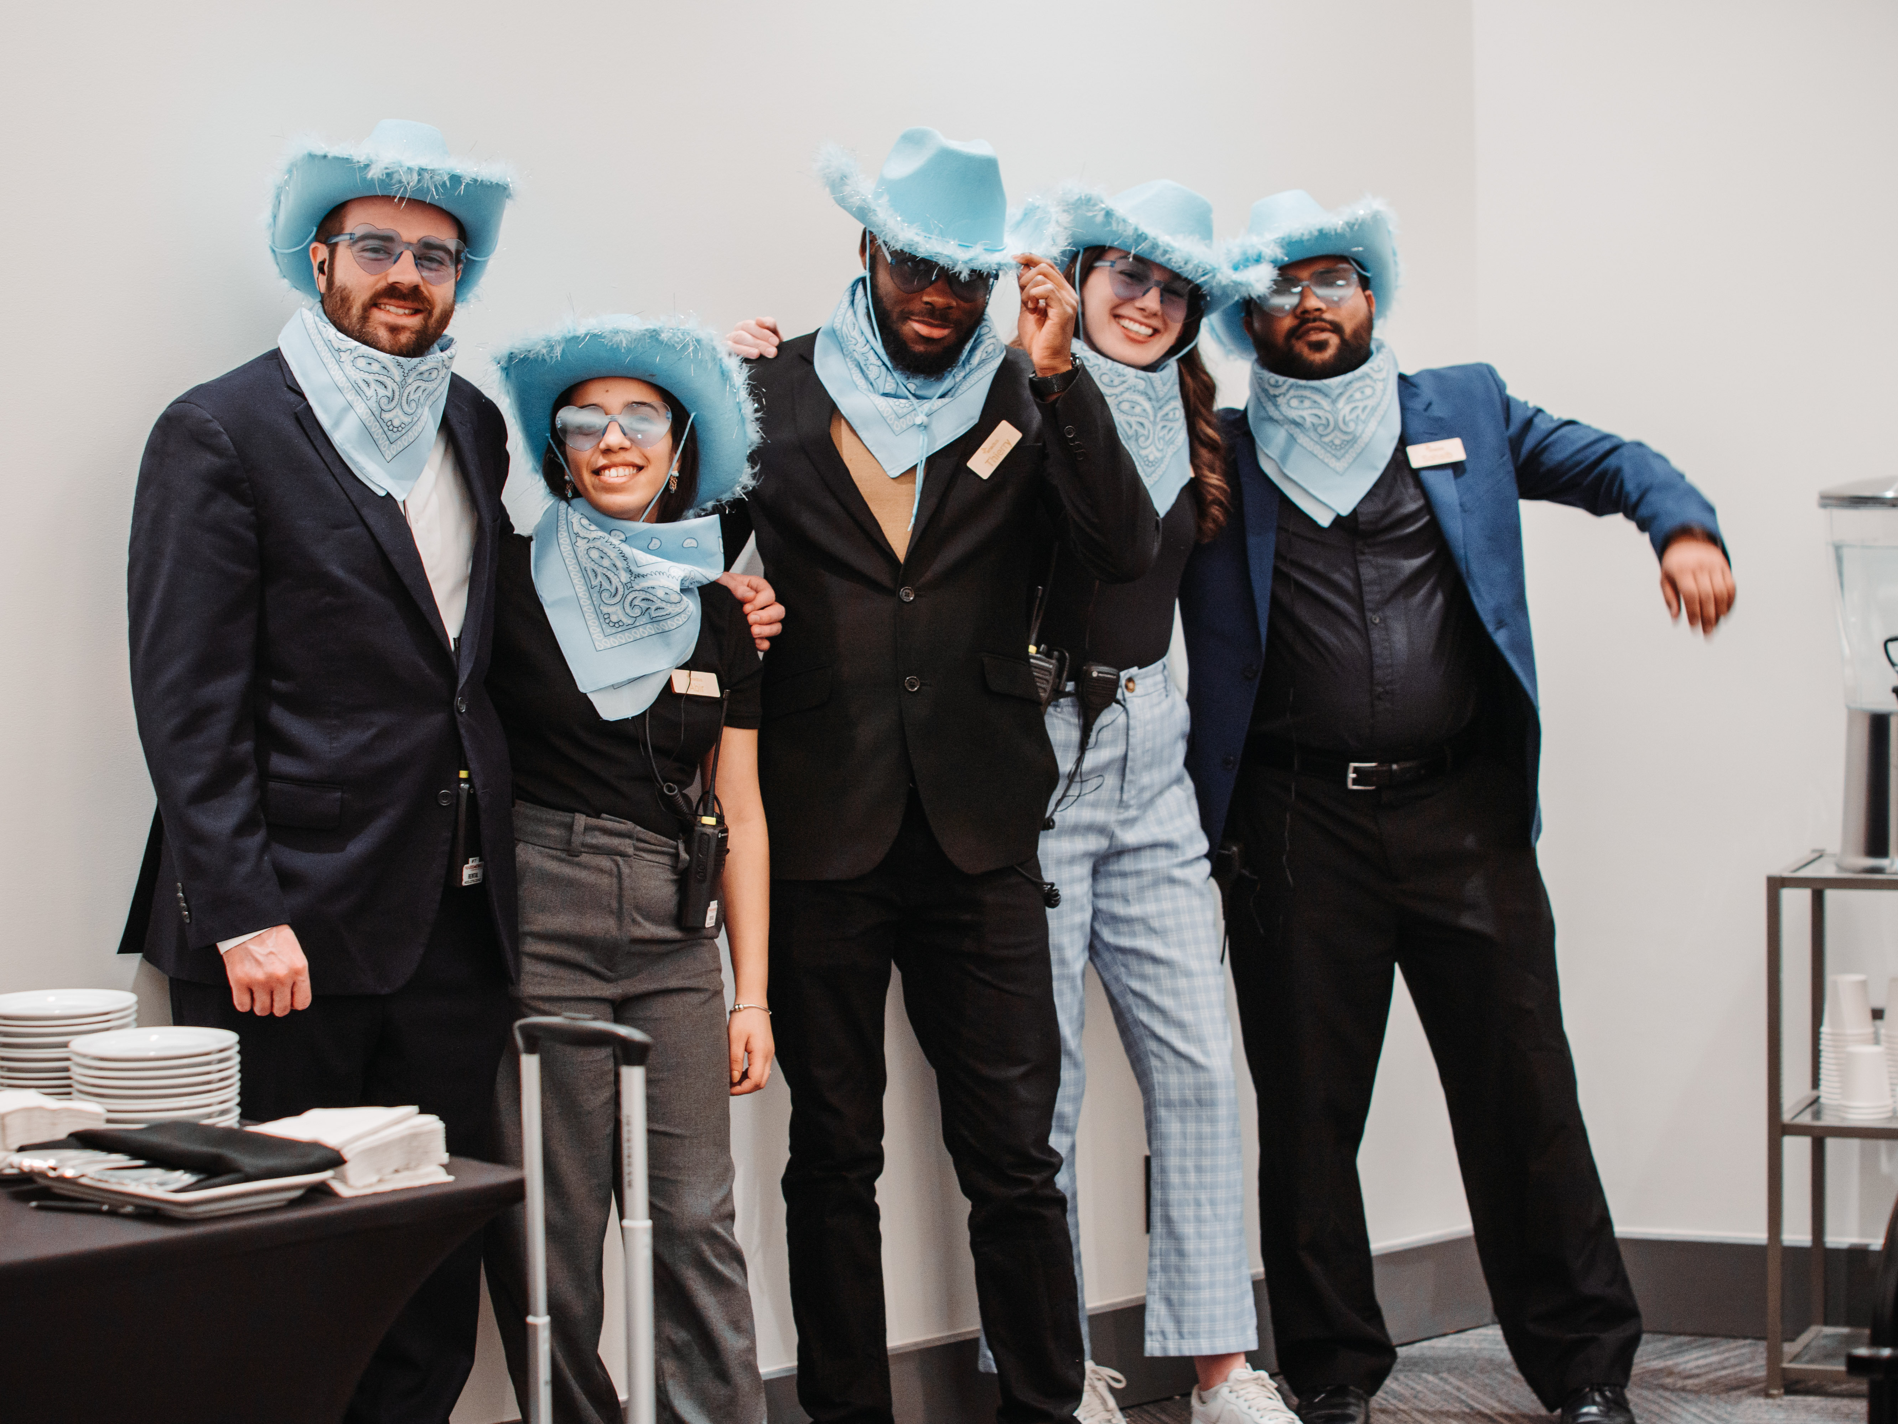
Welcome From Enactus Canada!
Notes:
Maddie

Slide 3
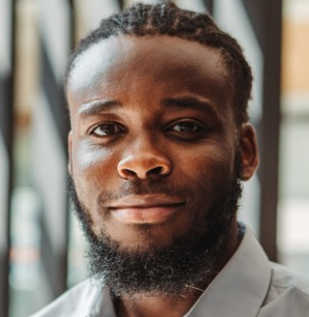

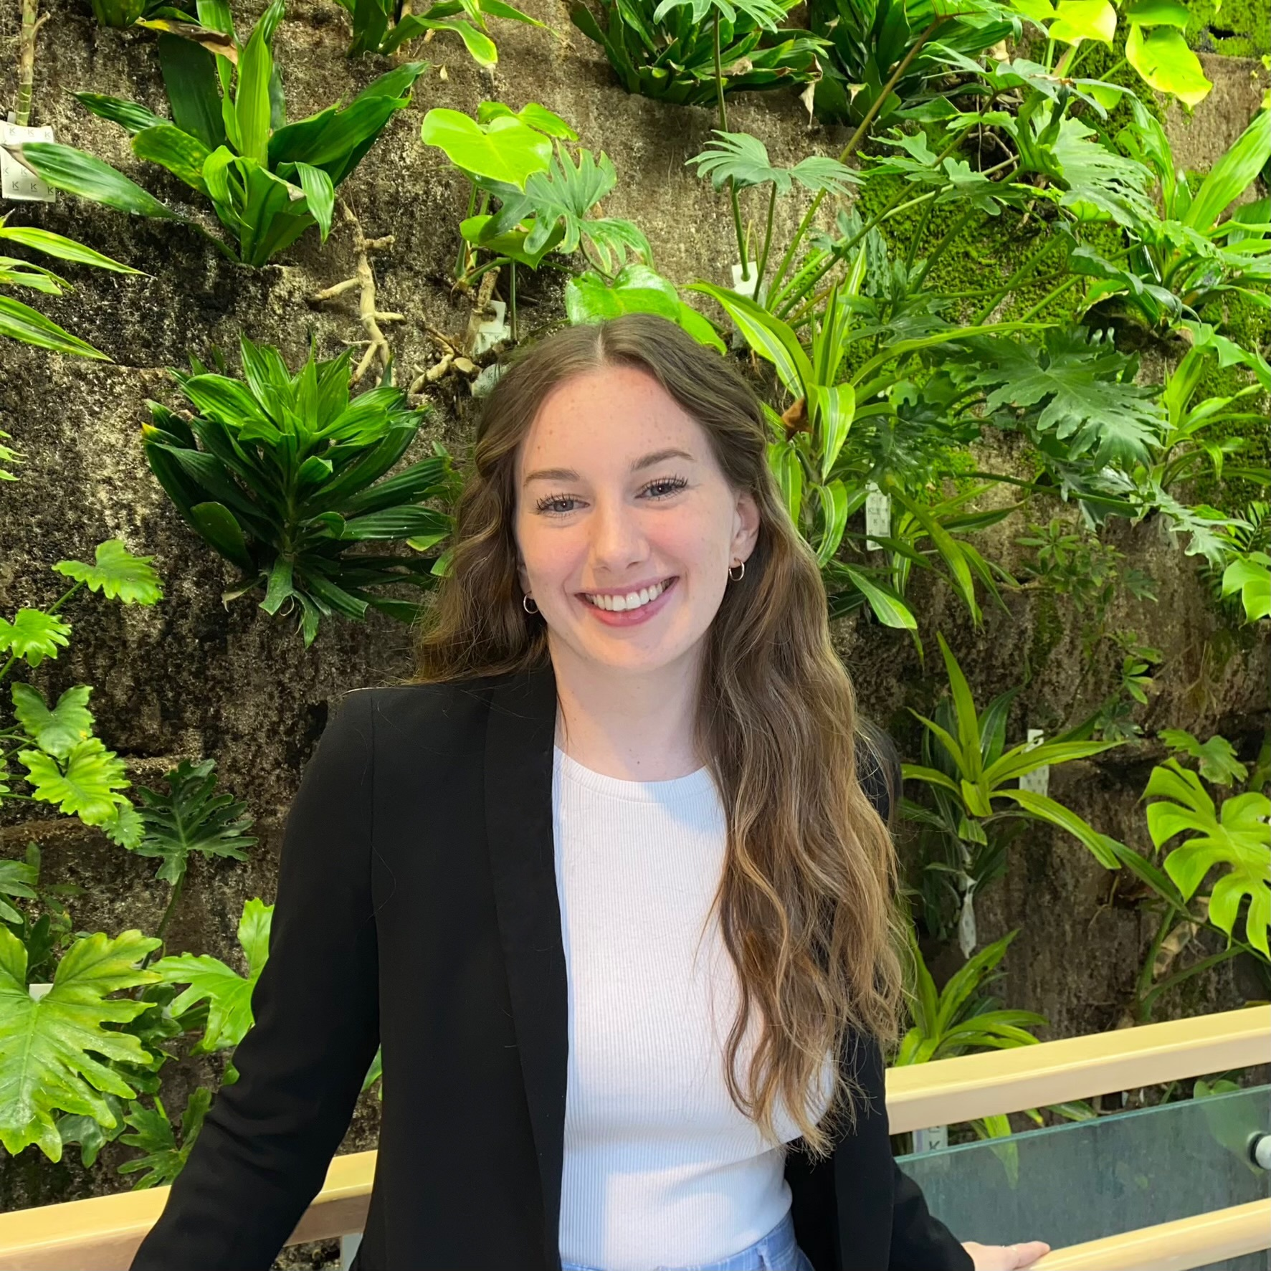
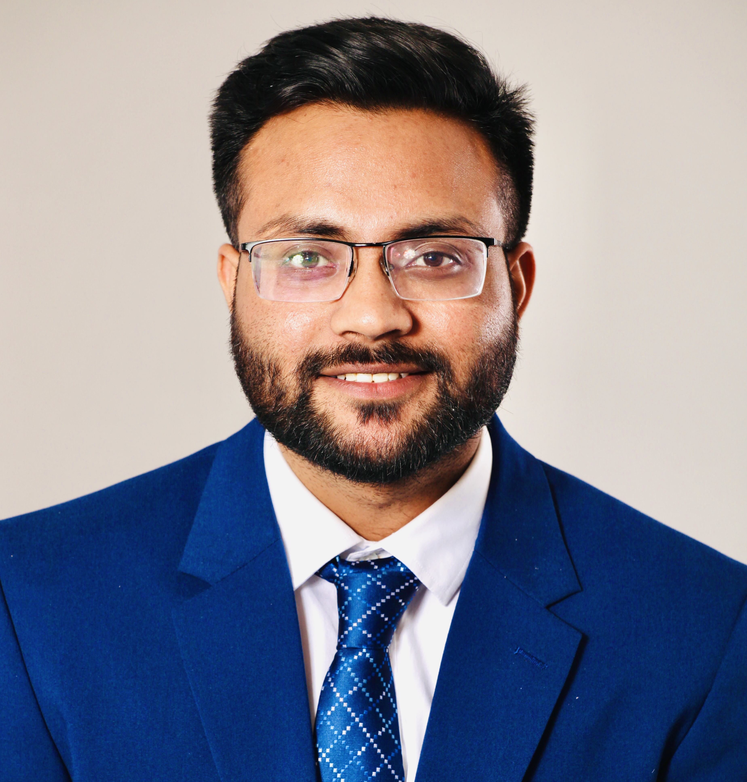
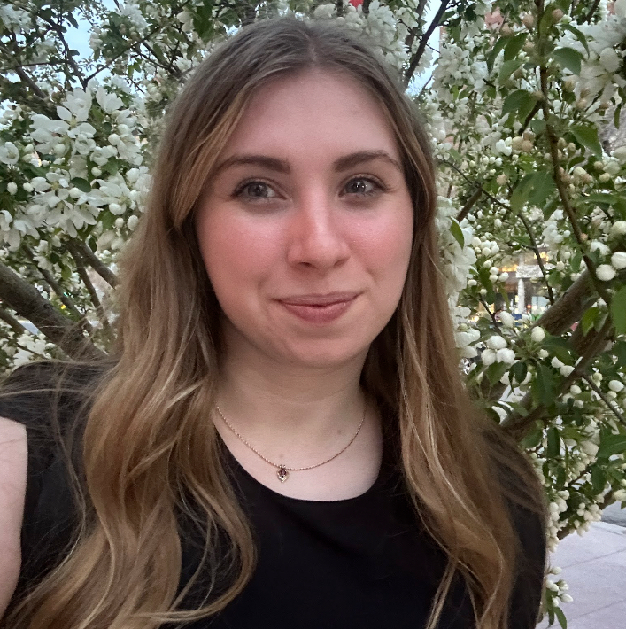
Meet the Program Managers!
Thierry Mateus
Program Manager
Bilingual
Eric MacPhee
Program Manager
Central Canada
Maddie Bristol
Program Manager
Atlantic Canada
Syed Sohaib
Program Manager
Western Canada
Abigail Austin
Program Manager
Central Canada
Notes:
All

Slide 4
Breakout Room
(Français)
Notes:
Thierry to say in Français

Slide 5

Agenda
Updates
  R&R -> CACTUS
  Website
  Events & Deadlines
Overview of the Year
  Training Sessions
  Mental Wellness Ambassador Program
  Project Accelerators
  Collaboration Summits
  Student Entrepreneur
  Awards & Bursaries
  Expositions
Additional Resources
  Team Resources
  Career Connections
  Data Collection and Reporting
  Questions
Notes:
Maddie

Slide 6
Start Here: CACTUS & Website
Your team's first steps & this year's key updates
Notes:
Eric

Slide 7
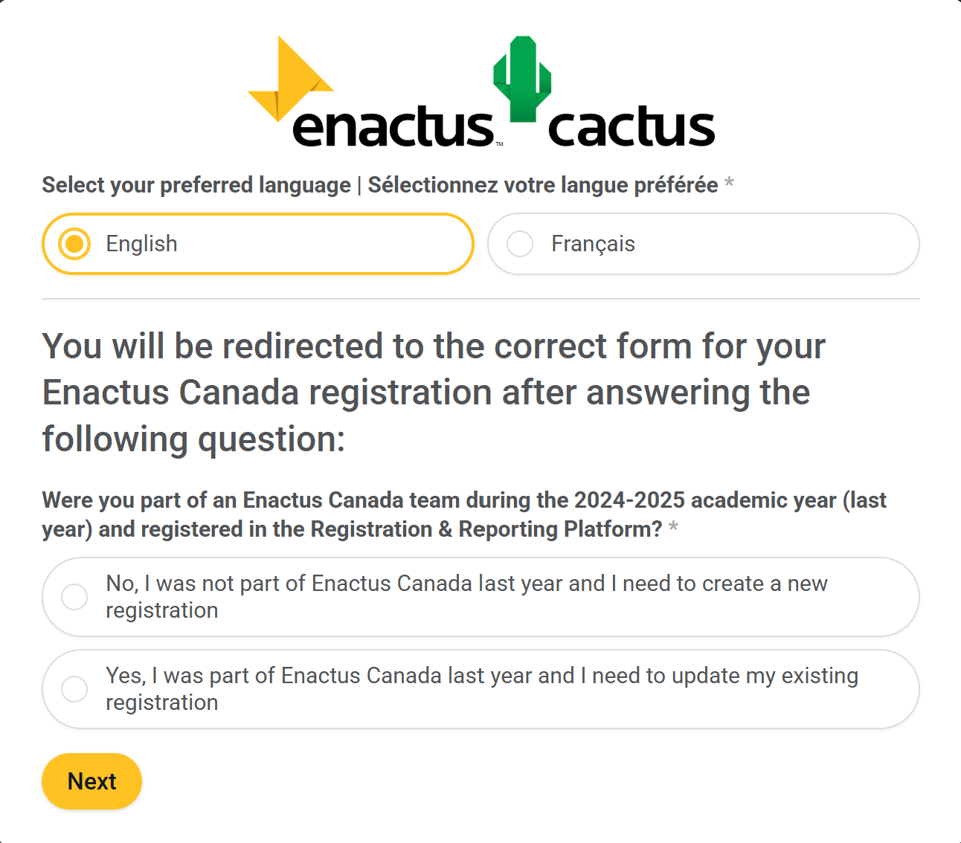
Welcome to Enactus CACTUS!
(Community Action Centre To Unlock Success)
Registration & Reporting Platform is now CACTUS — the hub for:
Event registration (Training Sessions, Expositions, Summits, etc.)
Volunteer Hour Tracking
Final Reporting
Awards/Bursaries Nominations
Project Accelerator Applications
And more!
Register for 2025-2026 in CACTUS today!
Notes:
Eric

Slide 8
Enactus CACTUS Changes
New this year:
One bilingual form (English & Français) for all forms
Returning members update profiles; new members register
Register for 2025-2026 in CACTUS today!
Notes:
Eric

Slide 9

cactus.enactus.ca
Enactus CACTUS is available at cactus.enactus.ca:
Everything in one place – All active links to CACTUS forms (e.g. Enactus Canada Program Registration, Volunteer Hour Submissions, Regionals/Nationals Registration, etc.) under “Important Links”
More transparency – Learn more about all teams across Canada, explore what they’re working on, and get inspired.
This year, only one (1) individual from every team will be given access to login on CACTUS (Program Managers will confirm who that is with each team):
Better visualization – See and edit your team’s volunteer hours, members, projects and more!
Historical data – You’ll be able to see your team’s previous competition materials & results, Final Reporting, and more!
New features and updates will continue throughout the year to better support your team. Send any requests or UI changes to programs@enactus.ca.
Notes:
Eric
All you'll be able to see is the get started button.
You'll be able

Slide 10
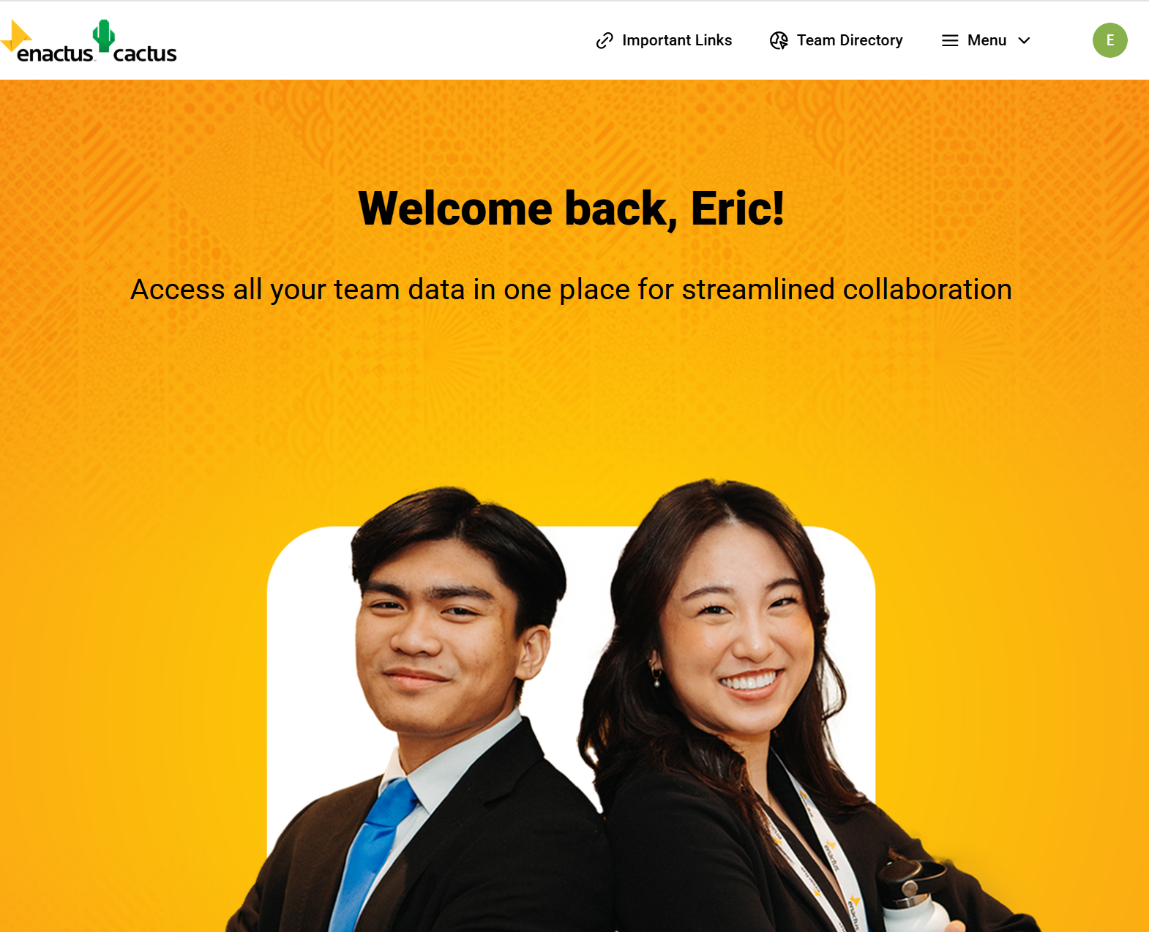
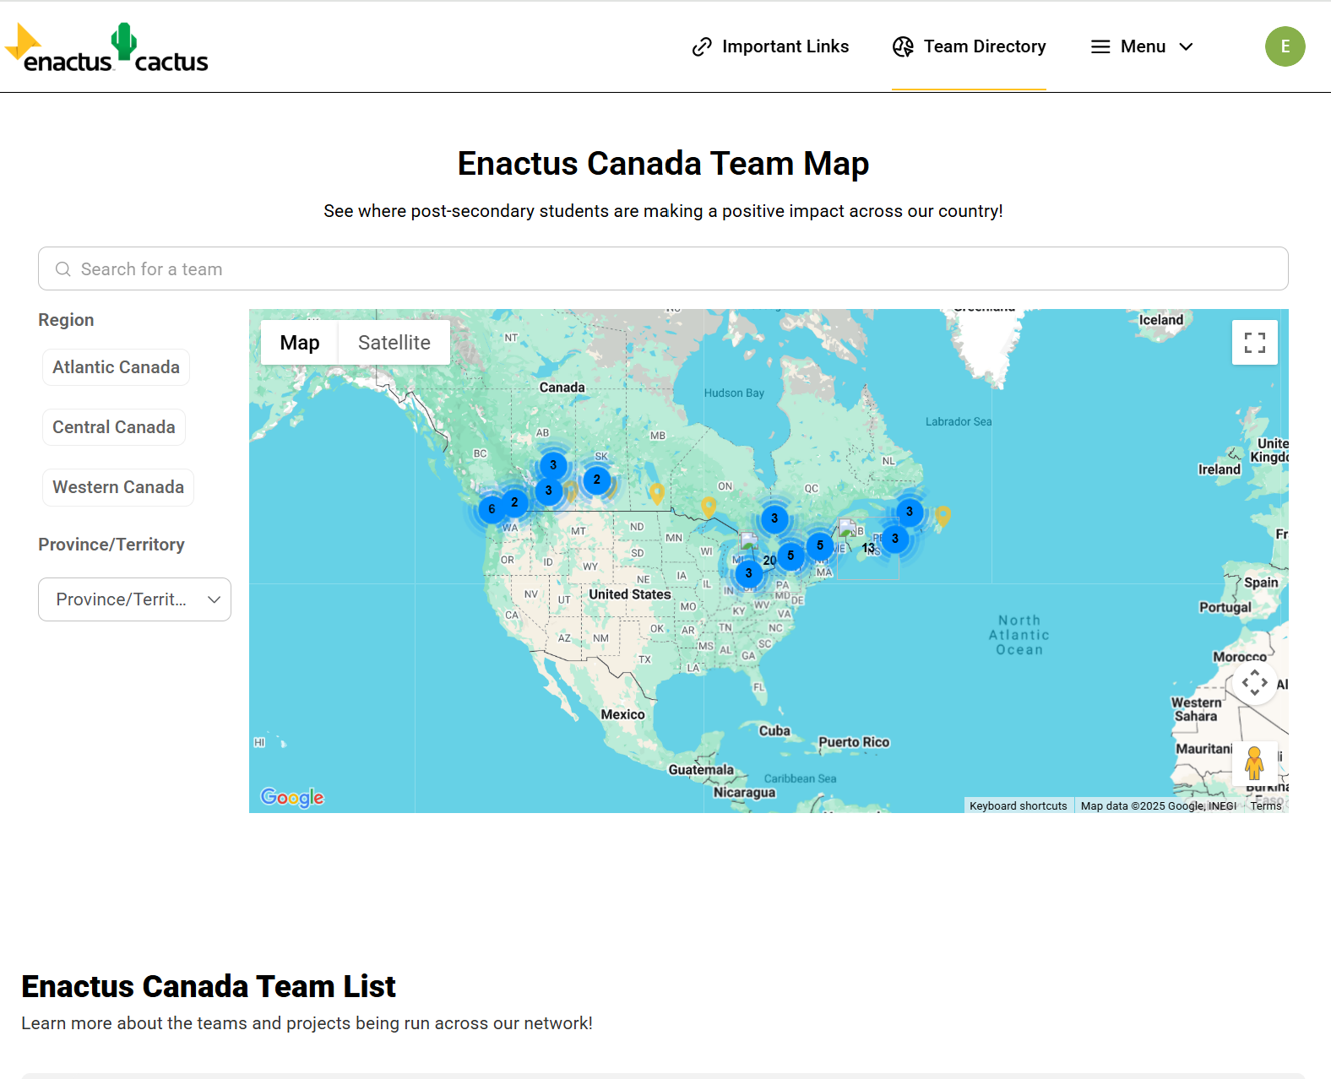
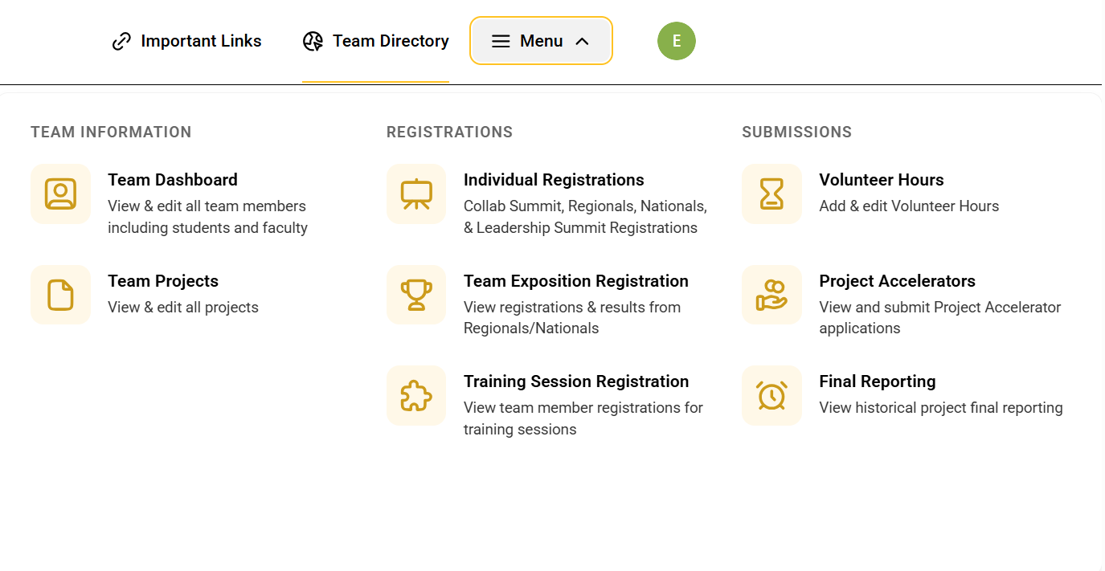
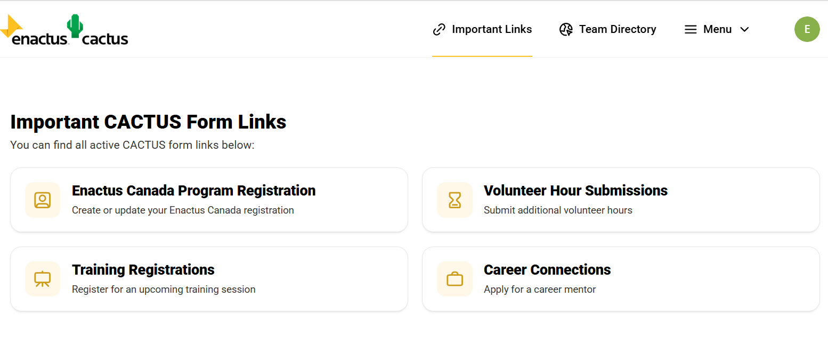
Notes:
Eric – probably have already gone here. Team Directory and Team Links. You won't be able to see access to the other things.
Important CACTUS Links. Will be public, open to everyone to be able to find links

Slide 11
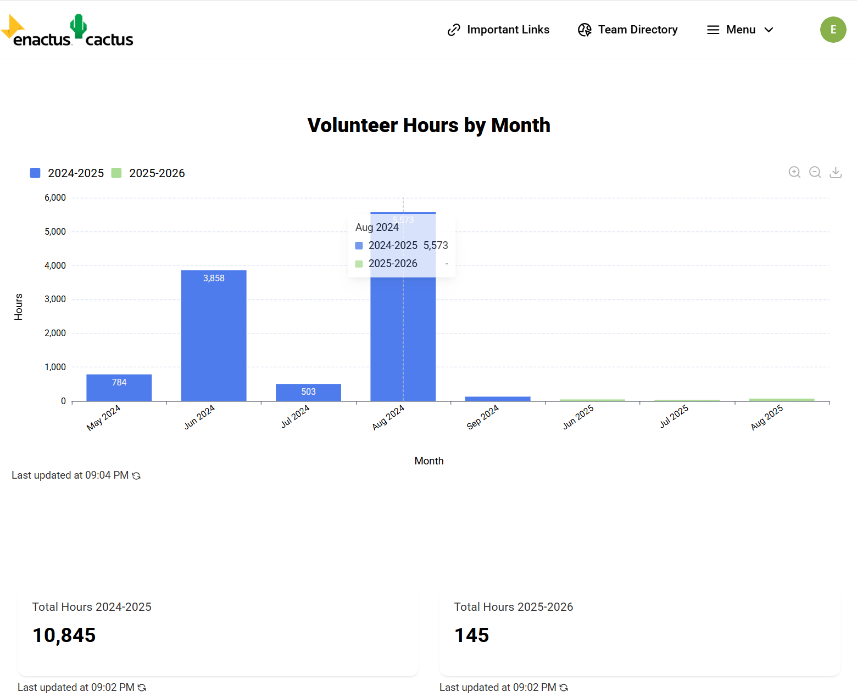
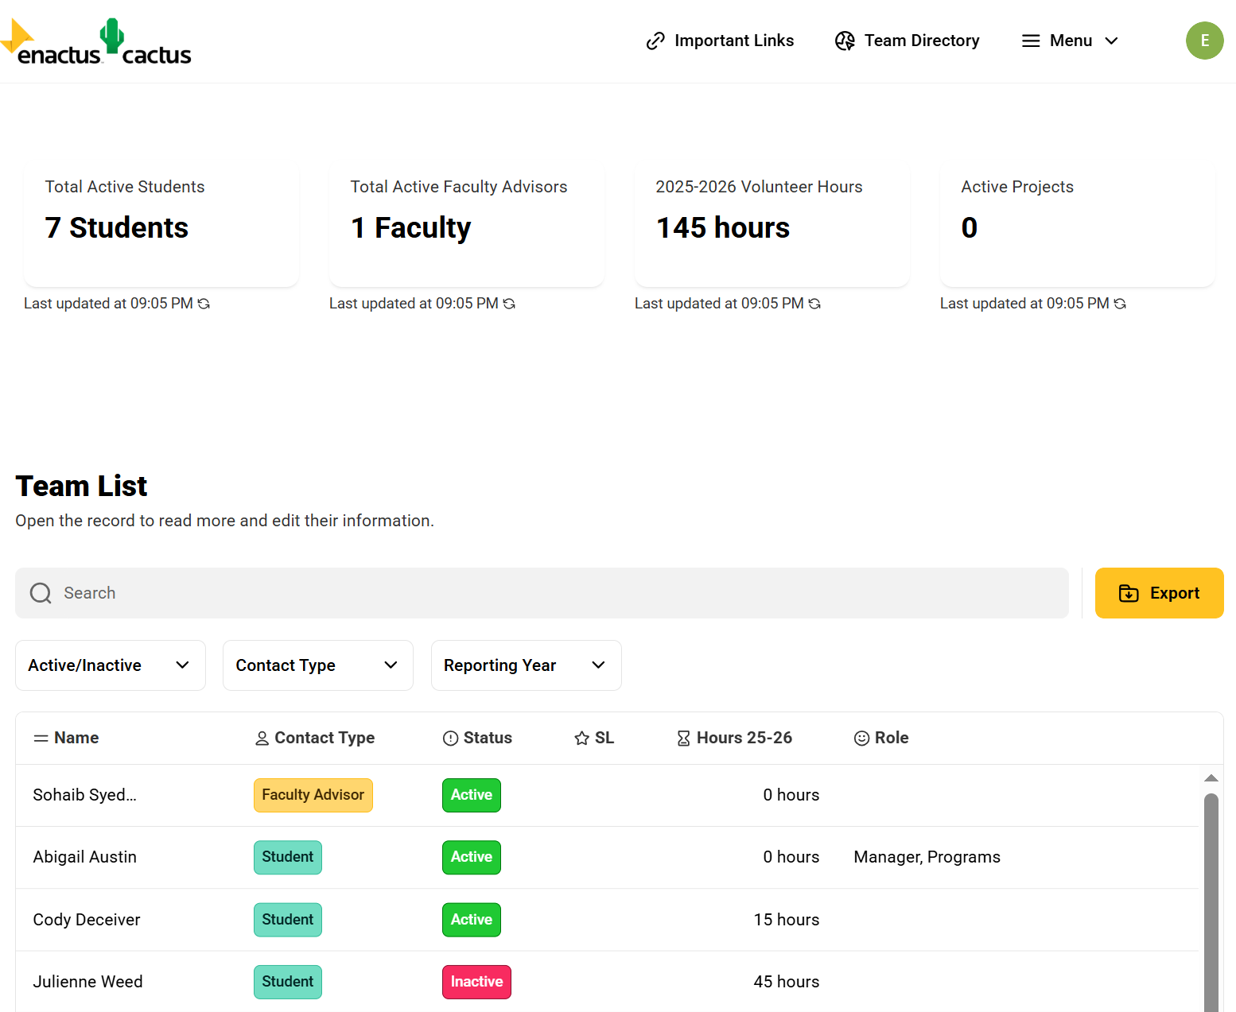
Notes:
Eric

Slide 12
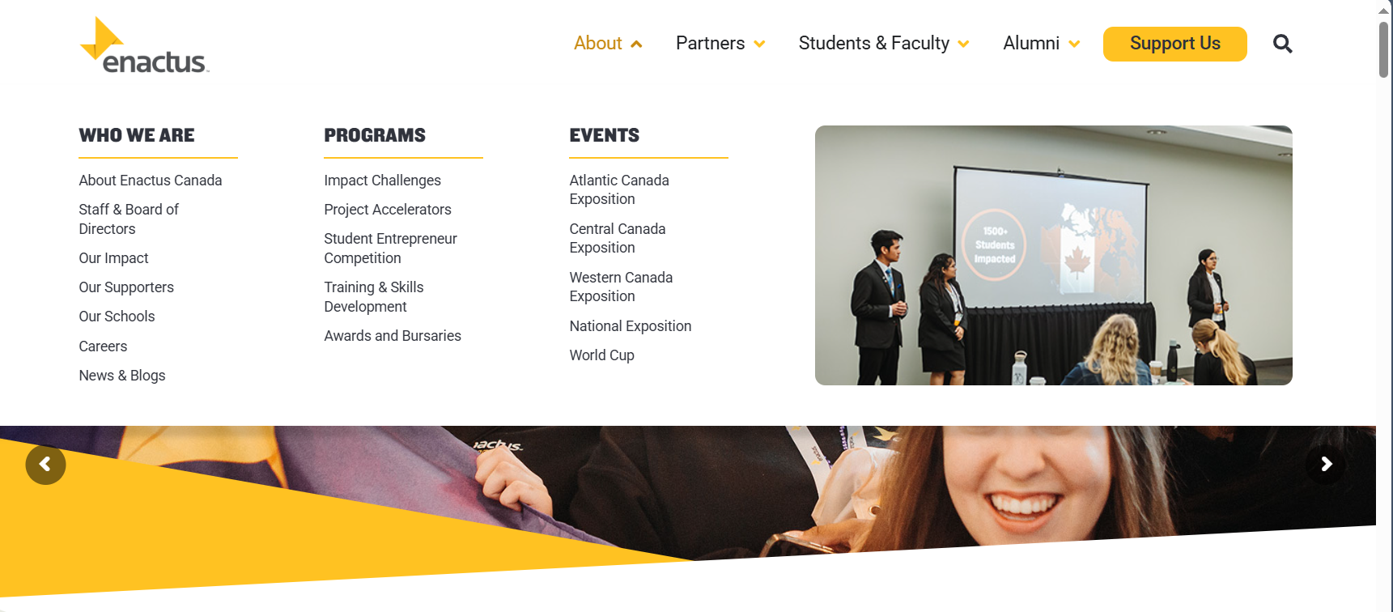
New Website! New Look, Same Address
https://enactus.ca/
Notes:
Maddie

Slide 13
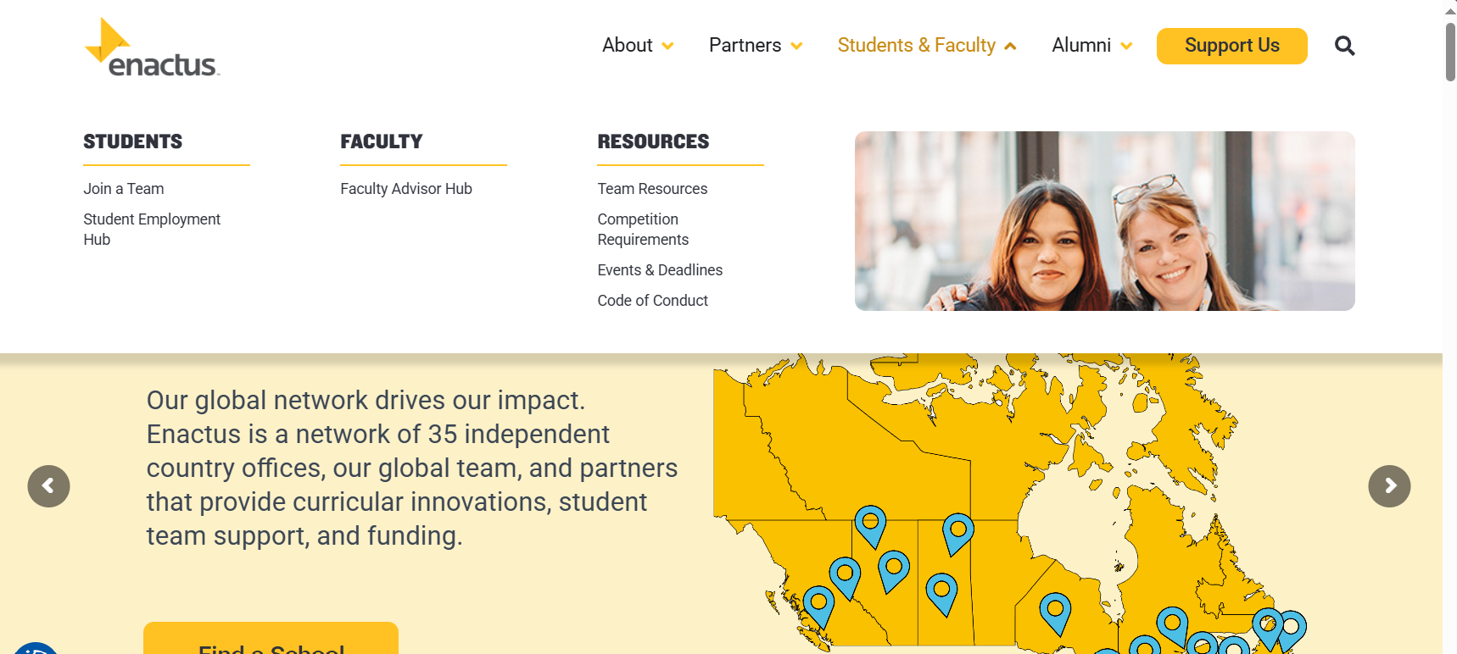
https://enactus.ca/
Notes:
please make sure that you note that the competition requirements now has all of the details for projects and competitions, FAQs etc. Impact Challenges section is a good example. if you need to go into that detail.
Only point to bring up here – Team Resources has been moved under Students & Faculty and no longer under it's own "Resources" like last year.

Slide 14
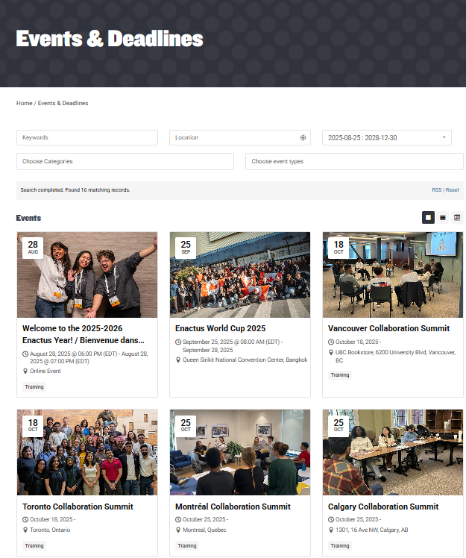
Events & Deadlines
"Important dates and deadlines" have been merged into one location
Link: https://enactus.ca/events/
Notes:
Maddie Say points about it's in one location. It is not in table form with a long list.

Slide 15
Events & Deadlines
You can Filter by Events, Competitions ...
Link: https://enactus.ca/events/
Notes:
Say points about how you can filter by event or deadline. Or by event type like Expositions, Training

Slide 16
Your Enactus Year:
From Kickoff to Nationals
Notes:
Abigail

Slide 17
Overview of the Year
Collaboration Summits
(Open to 2
student leaders per team)
Regional Expositions
Atlantic: Halifax
February 26th – February 27th, 2026
Western: Vancouver
March 12th - 13th, 2026
Central: Toronto
March 17th -18th, 2026
National Exposition
Location: Montreal
Palais des Congrès de Montréal
May 6th - 8th, 2026
Leadership Summit
Takes place after National Expo
Project Accelerators
Launching September 22nd, 2025!
More Info Coming soon
Enactus World Cup
Location: Bangkok, Thailand
September 25th – 28th, 2025
• October 18 – Toronto
• October 18 – Vancouver
• October 25 – Calgary
• October 25 – Montreal
• November 1 – Halifax
August -September:
Fall Recruitment
Oct - Dec:
Project Development
January - February:
Winter Recruitment
Jan - May:
Project Development
Regionals and Nationals Preparation
May - July:
Team Succession
Typical Year For Enactus Teams
Notes:
abi

Slide 18
Fall Kickoff
(Sept. – Nov.)
Notes:
Abi

Slide 19
Training Sessions
Purpose: Virtual sessions designed to help you develop your skills, support team and project development and prepare for success both within Enactus and in your future career.
When: Throughout the year
Example Topics Covered: Brand Marketing, Competition Prep and more!
How to Register: Through the CACTUS training registration here!
  Reminder: Must be first registered into the Enactus program through CACTUS first!
Confirmed Upcoming training sessions
  Marketing Training Series – 4 sessions – 3 of 4 attended to receive LinkedIn badge
    First session: September 18, Enactus Brand Foundations
More information, click here.
Notes:
Abi

Slide 20

Mental Wellness Ambassador Program
Proudly presented by the Co-Operators
Max. 1 Ambassador per Enactus team
Champions mental wellness education & awareness on campus
Ambassadors receive training + resources to engage their teams
Key Dates:
  Launch: September 6, 2025
  Deadline: TBD
  Acceptances sent out soon after your submission.
Notes:
Sohaib

Slide 21
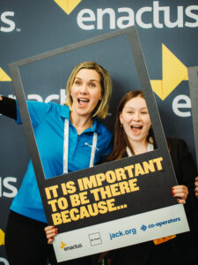
Mental Wellness Program – Changes/Updates
Recruitment Process
Workshops & Toolkit
Financial Support
  Mental Hygiene: Caring for Your Own Mental Health.
  Trauma-Informed Peer Support & Self-Compassion.
  Healthy Coping Mechanisms for Stress.
  Resource Toolkit with ideas, materials, and templates for mental health activities.
No formal application process from Enactus
Enactus teams have the opportunity to recruit and appoint their own Mental Wellness Ambassador.
$500 for each MWA to support events and activities.
NEW: Extra $500 for the team if the MWA attends Nationals.
Notes:
Sohaib

Slide 22
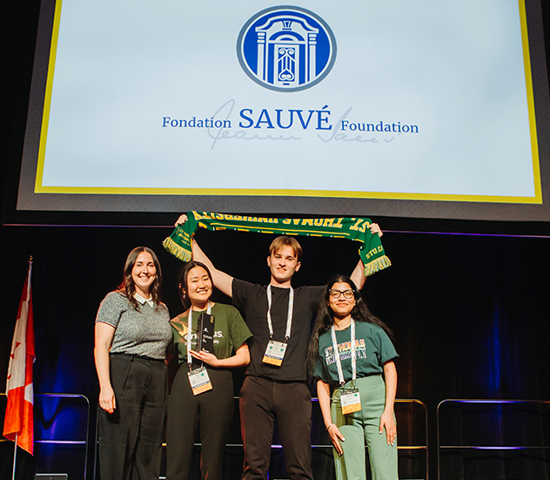
Project Accelerators
Application Process: Submit via online application form on CACTUS
  Available on launch date
Key Dates:
  Launch: September 22, 2025
  Deadline: October 6, 2025
  NEW: Mid-Year Report – January 2026
  Final Impact Report – April 2026
Funding: 75% released in Fall, remaining 25% released after required reports
Awards & Recognition
  Some include awards & additional prize money
  Winners announced at National Exposition (May 2026)
Notes:
Maddie
Purpose: Project Accelerators empower Enactus teams with essential funding to advance their innovative projects, helping to tackle strategic issues that align with our partner companies' goals. This funding comes from the partner company that is supporting the respective Project Accelerator

Slide 23
List of Project Accelerators
Returning:
Alterna Savings SDG (Ontario Only)
Jeanne Sauvé Global
National Bank Indigenous Inclusion
PC Financial Resilience
New:
Jeanne Sauvé Workplace Inclusion
Ralph M. Barford Equal Access
RBC Skills for a Thriving Future
Additional PA (details to come)
More information to Project Accelerators, click here!
Notes:
Maddie
Sentence on each;
JS Workplace - promote accessibility, equity, and inclusion for employees with disabilities.
Ralph - promote equality and access across various sectors, including education, healthcare, technology, environmental justice, food security, housing, and economic opportunity.
RBC - help all Canadians prepare for a rapidly changing workforce through work readiness skill development.

Slide 24


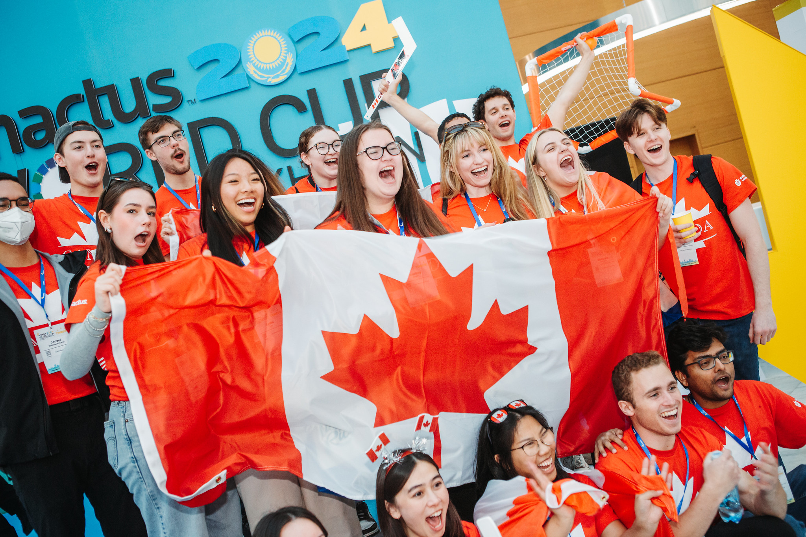
50th Anniversary – Enactus World Cup
Not too late to register: Click Here
Notes:
Abi
Not too late to register
Mention about WhatsApp chat . We will be sending out more information next week to those who have registered from Canada
Live stream
More details to come

Slide 25
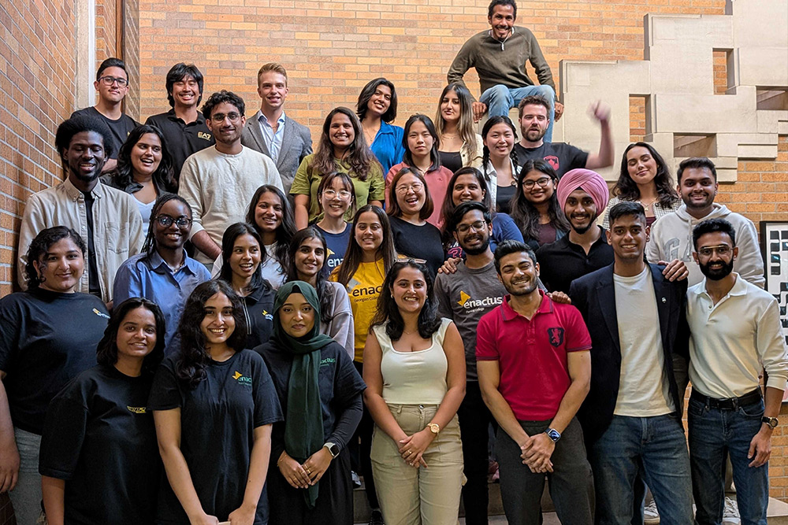
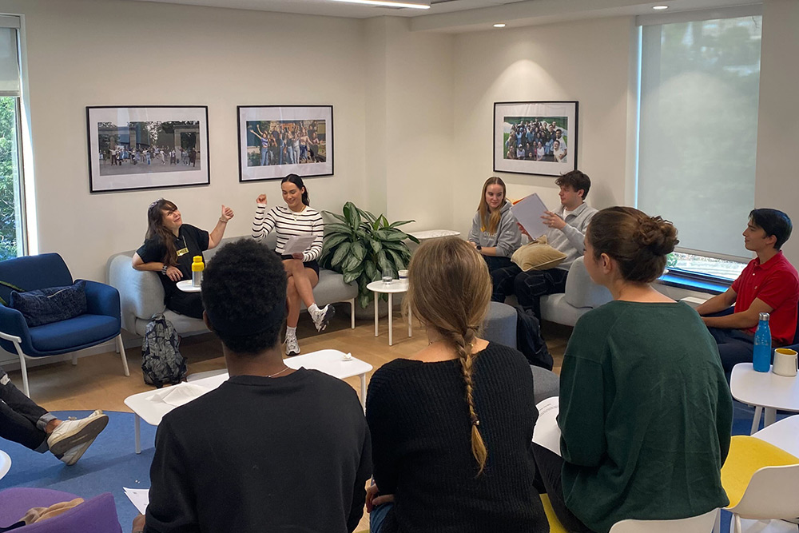
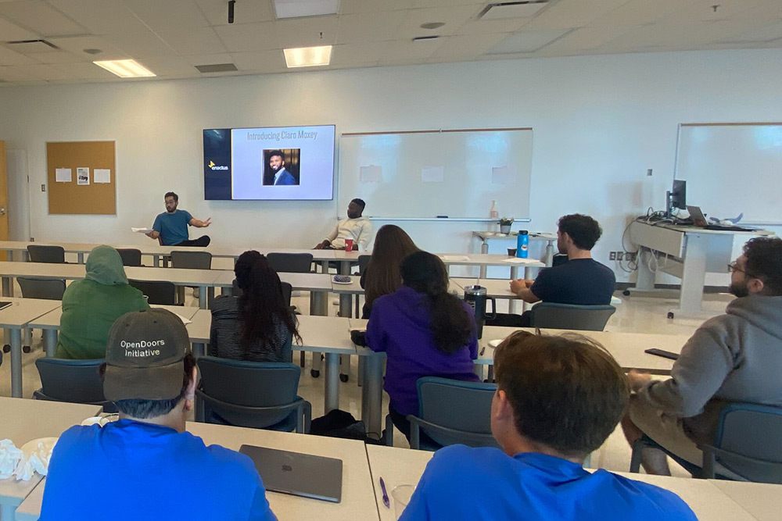
Collaboration Summits
Collaboration Summits – The Summits engage student leaders in fireside chats with local leaders in sustainability, social entrepreneurship, and community development. Lunch Provided. Times TBA
Who can attend? 2 students from each team can attend (check with your Faculty Advisors and Student Presidents)
Registration: Coming soon (details can be found for each summit below)
October 18th
October 25th
November 1st
Vancouver
Toronto
Montréal
Calgary
Halifax
Notes:
Abigail

Slide 26
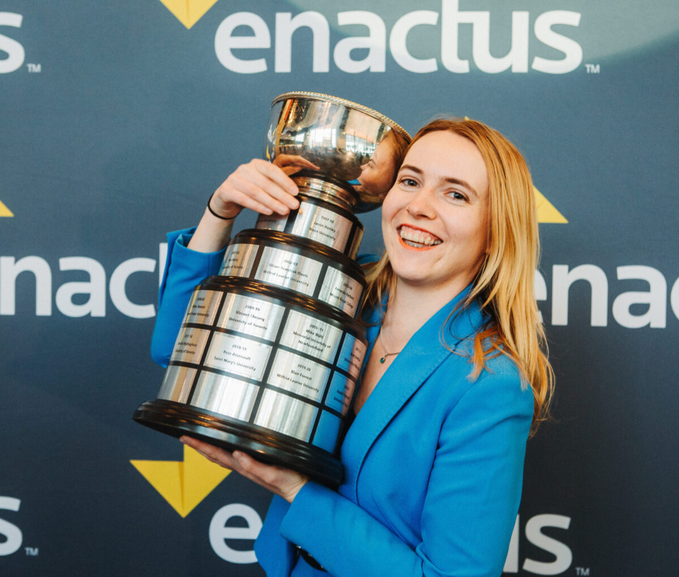
Student Entrepreneur Competition
Nomination & Application Process: Submit via online application form on CACTUS
  Available on launch date
Key Dates:
  Launch: October 22, 2025
  Nomination Deadline: December 5, 2025
  Application Deadline: January 5, 2026
Prizes: $16,000 to be won!
More information on Student Entrepreneur, click here!
Notes:
Eric

Slide 27

Awards & Bursaries
Bursaries
$52,500 available this year for tuition support
Deadline: November 28, 2025
Winners notified: Winter 2026 Semester
Awards
Recognition for students, faculty & academic leaders
Deadline: March 27, 2026
Winners announced: National Exposition (May 2026)
Includes: Student Leader, Project Manager, Woman Leader, Spirit of Enactus, Student Engagement, Tech of the Year
Information will be available on website!
More information: Awards & Bursaries
Notes:
Eric

Slide 28
Winter Semester/Event Season
(Jan. - May)
Notes:
Maddie

Slide 29
Enactus Canada Expositions
Regional Expositions
  Atlantic: Halifax - February 26th - February 27th, 2026
  Western: Vancouver - March 12th - 13th, 2026
  Central: Toronto - March 17th -18th, 2026
  Leadership Summit: 1st day of Regionals
National Exposition
  Location: Montréal
  Palais des Congrès de Montréal
  May 6th - 8th, 2026
  Leadership Summit: Following the National Exposition
Save the dates here!
Notes:
Maddie

Slide 30
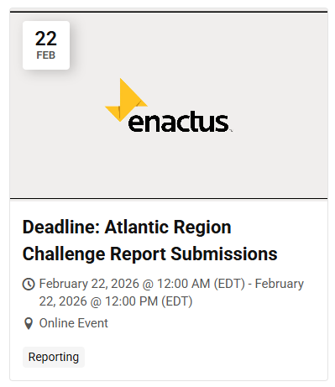
Final Reporting Dates & Deadlines
Regionals Challenge Report Due
  Atlantic: February 22, 2026
  Central/Western: March 8, 2026
Nationals
  Final Reporting Due: April 12, 2026
  Impact and Financial Reporting Review: Week of April 20, 2026
  Annual Report Deadline: April 29, 2026
Reporting Period
  Regionals : February 23, 2025 → February 22, 2026
  Nationals : April 13, 2025 → April 12, 2026
Notes:
Maddie

Slide 31
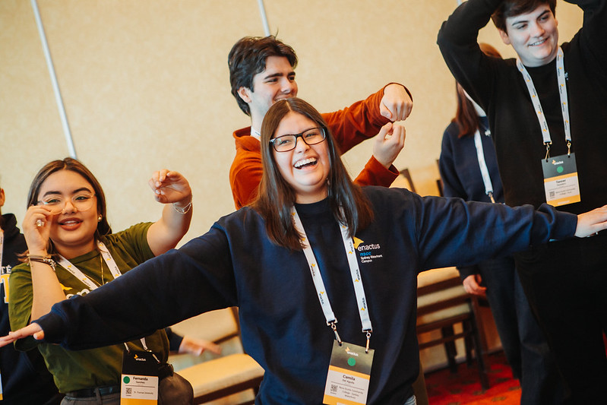
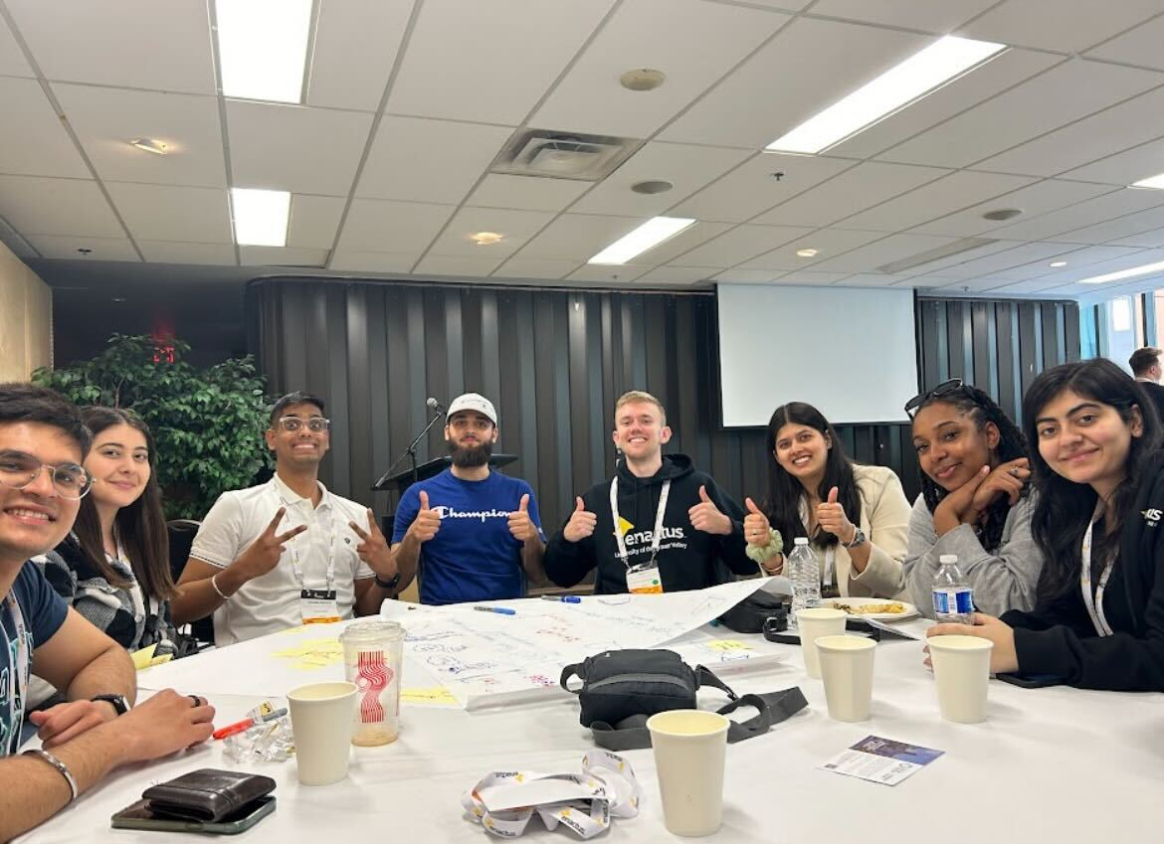
Leadership Summits
The summits bring incoming student leaders together to get to know one another, share best practices, and foster collaboration.
1st day of Regional Exposition
Following National Exposition
Notes:
Maddie

Slide 32



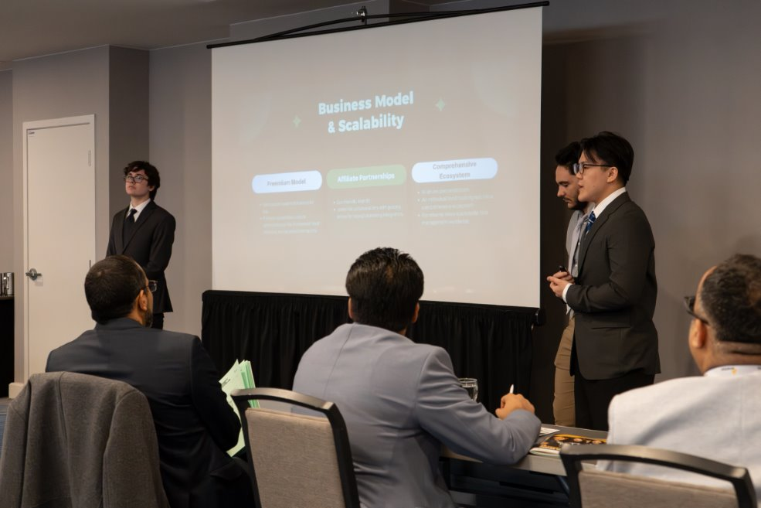
Impact Challenges
Canadian Tire Environmental Sustainability Challenge
Innovation and Impact Challenge, powered by Enactus Alumni
TD Entrepreneurship Challenge
Notes:
Sohaib

Slide 33


Impact Challenges
Desjardins Community Empowerment Challenge –
Updated!
Notes:
Sohaib

Slide 34
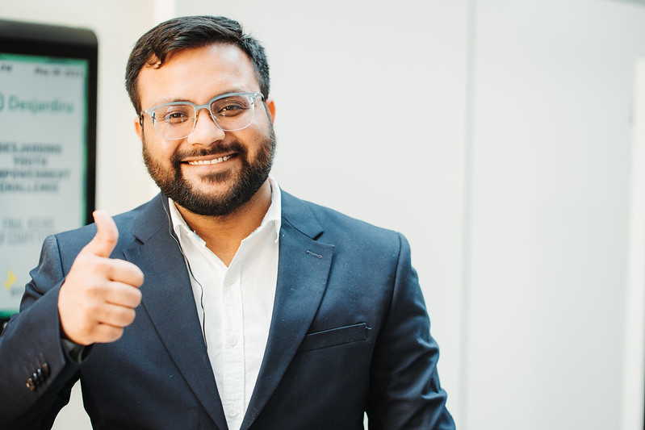
Social Enterprise Accelerator
→ Enactus Canada is launching a new national initiative to empower post-secondary students to build innovative social enterprises that tackle urgent social and environmental challenges in their communities.
→Through this accelerator, student teams will move from ideation to launch with the support of targeted training, personalized mentorship, and access to essential resources.
12 Weeks, 10 Teams in 1st cohort
Mentorship Opportunities
$1,500 upfront
Pitch for pool of $50, 000
If you are reading this, there are no photos of this challenge yet so here is a photo of Sohaib cheering you on for moral support.
Notes:
Abigail

Slide 35
Additional Support
Notes:
Eric

Slide 36
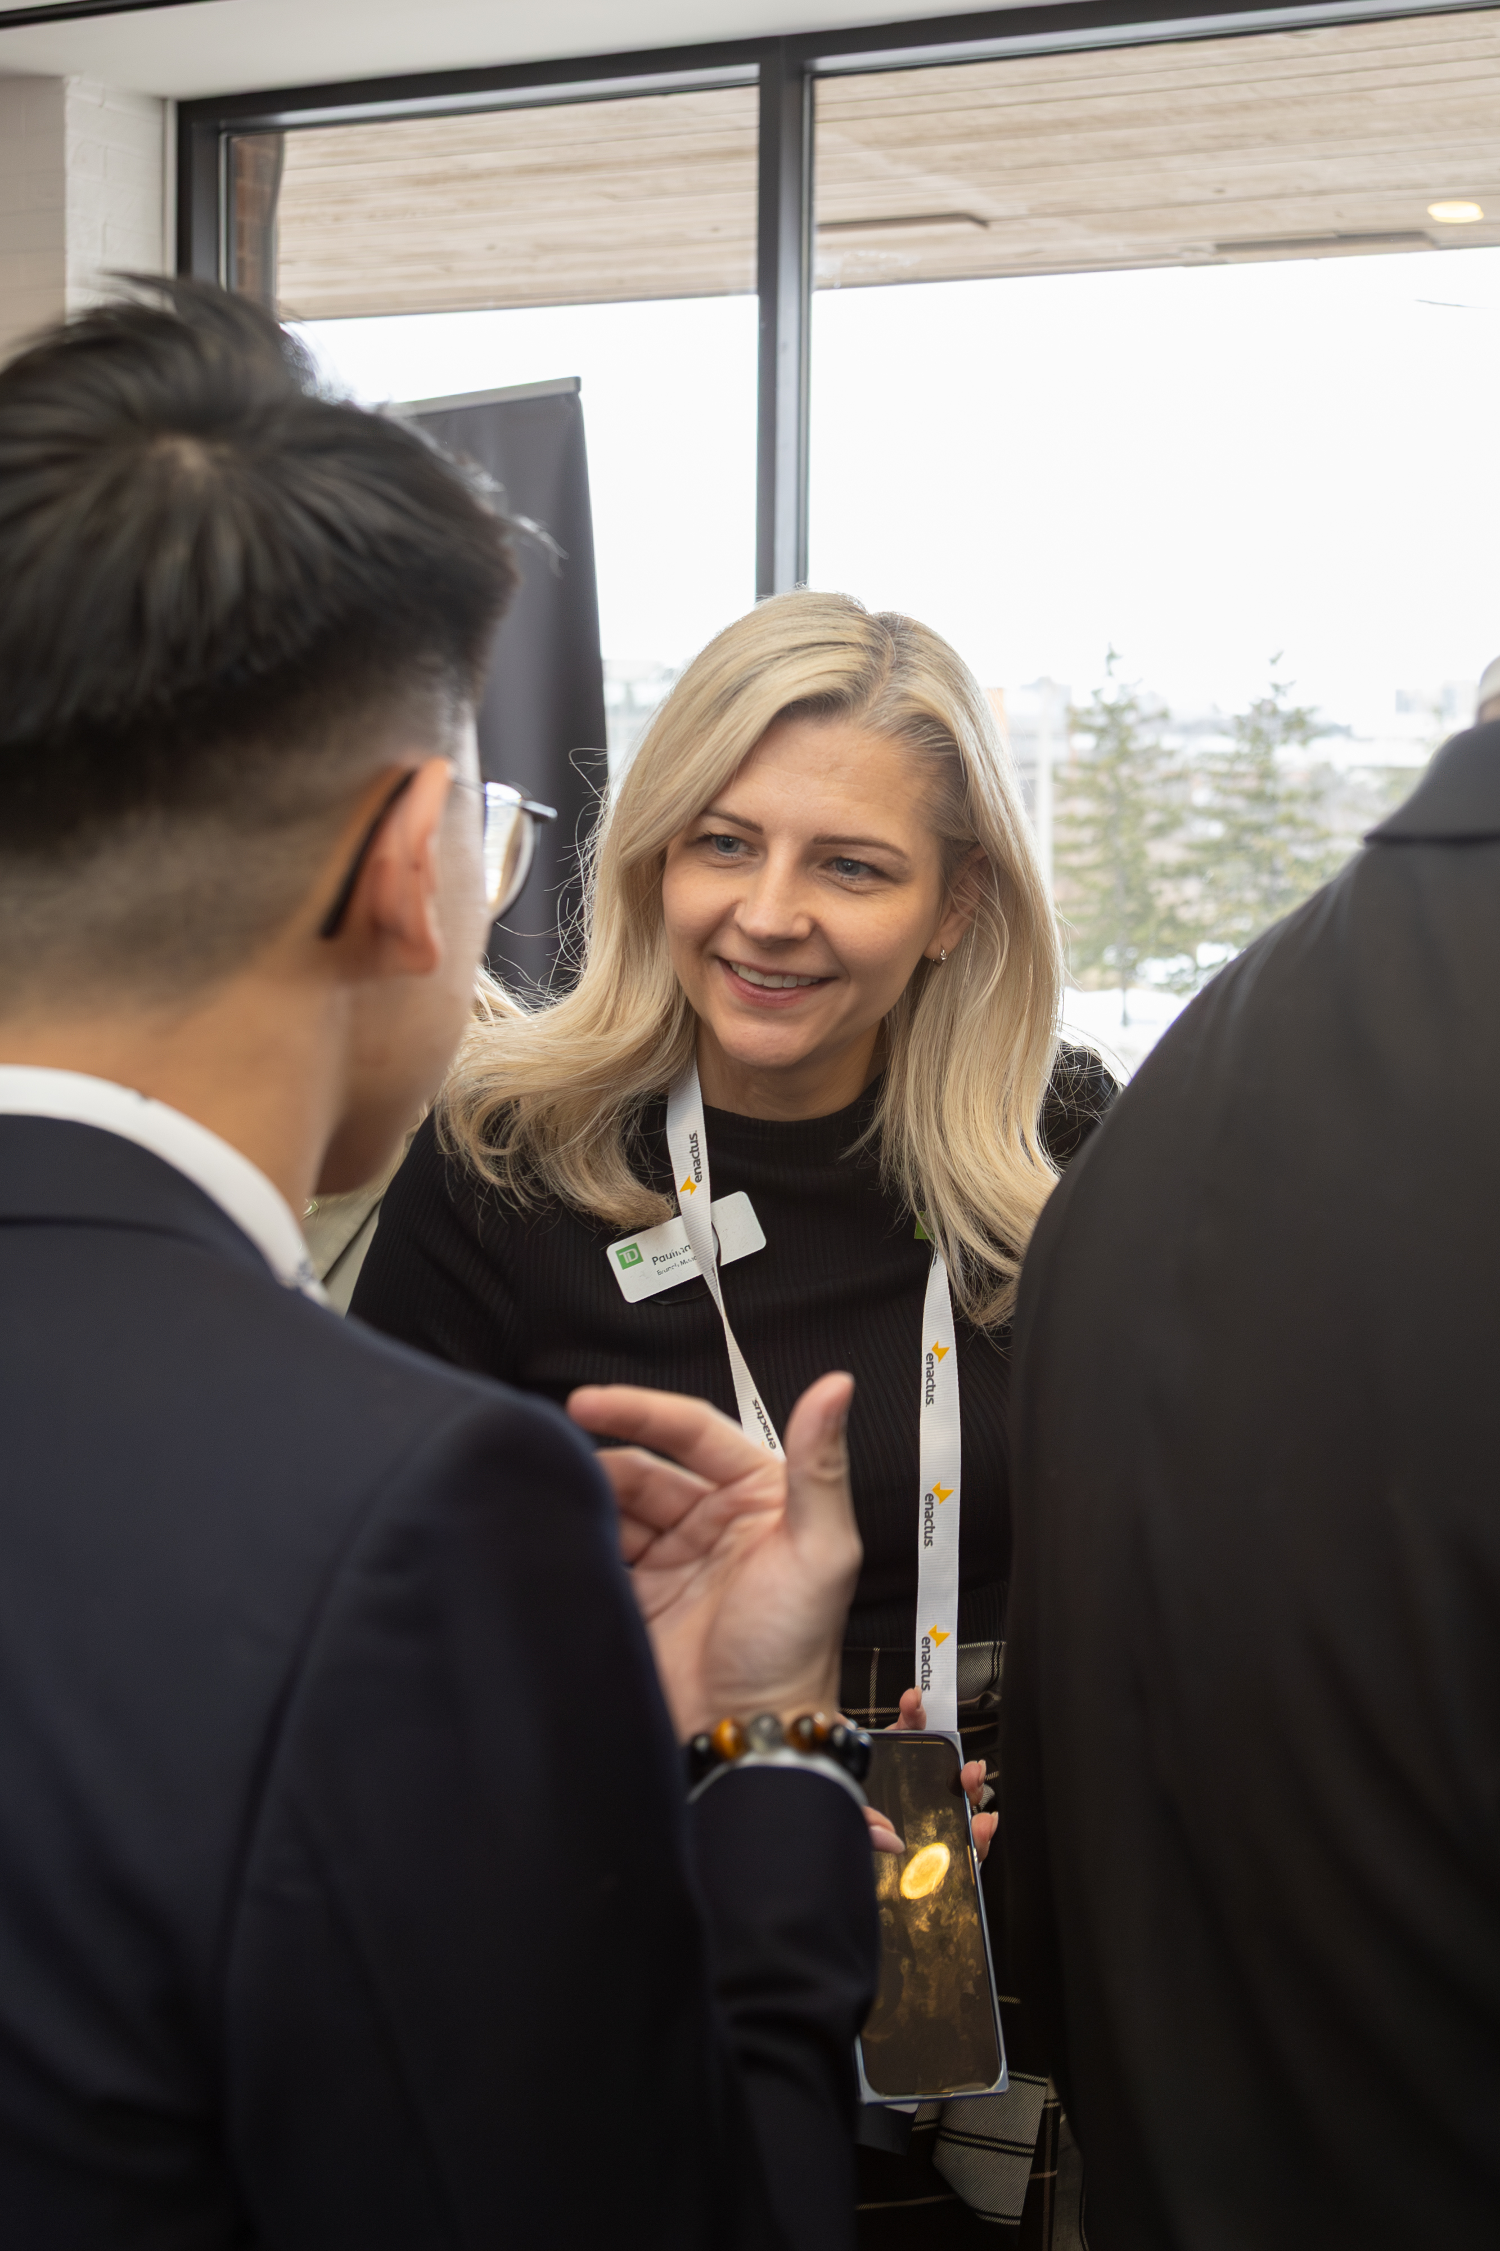
Team Resources
Team Resources
  Tech Presentation Strategies
  How to Create an Enactus Presentation
  Brand Guidelines
  Logos, graphics, fonts
  Direct vs. Indirect Impact Definitions
  Sample Annual Report
  Needs Assessment Template
Visit enactus.ca/resources
Notes:
Eric

Slide 37
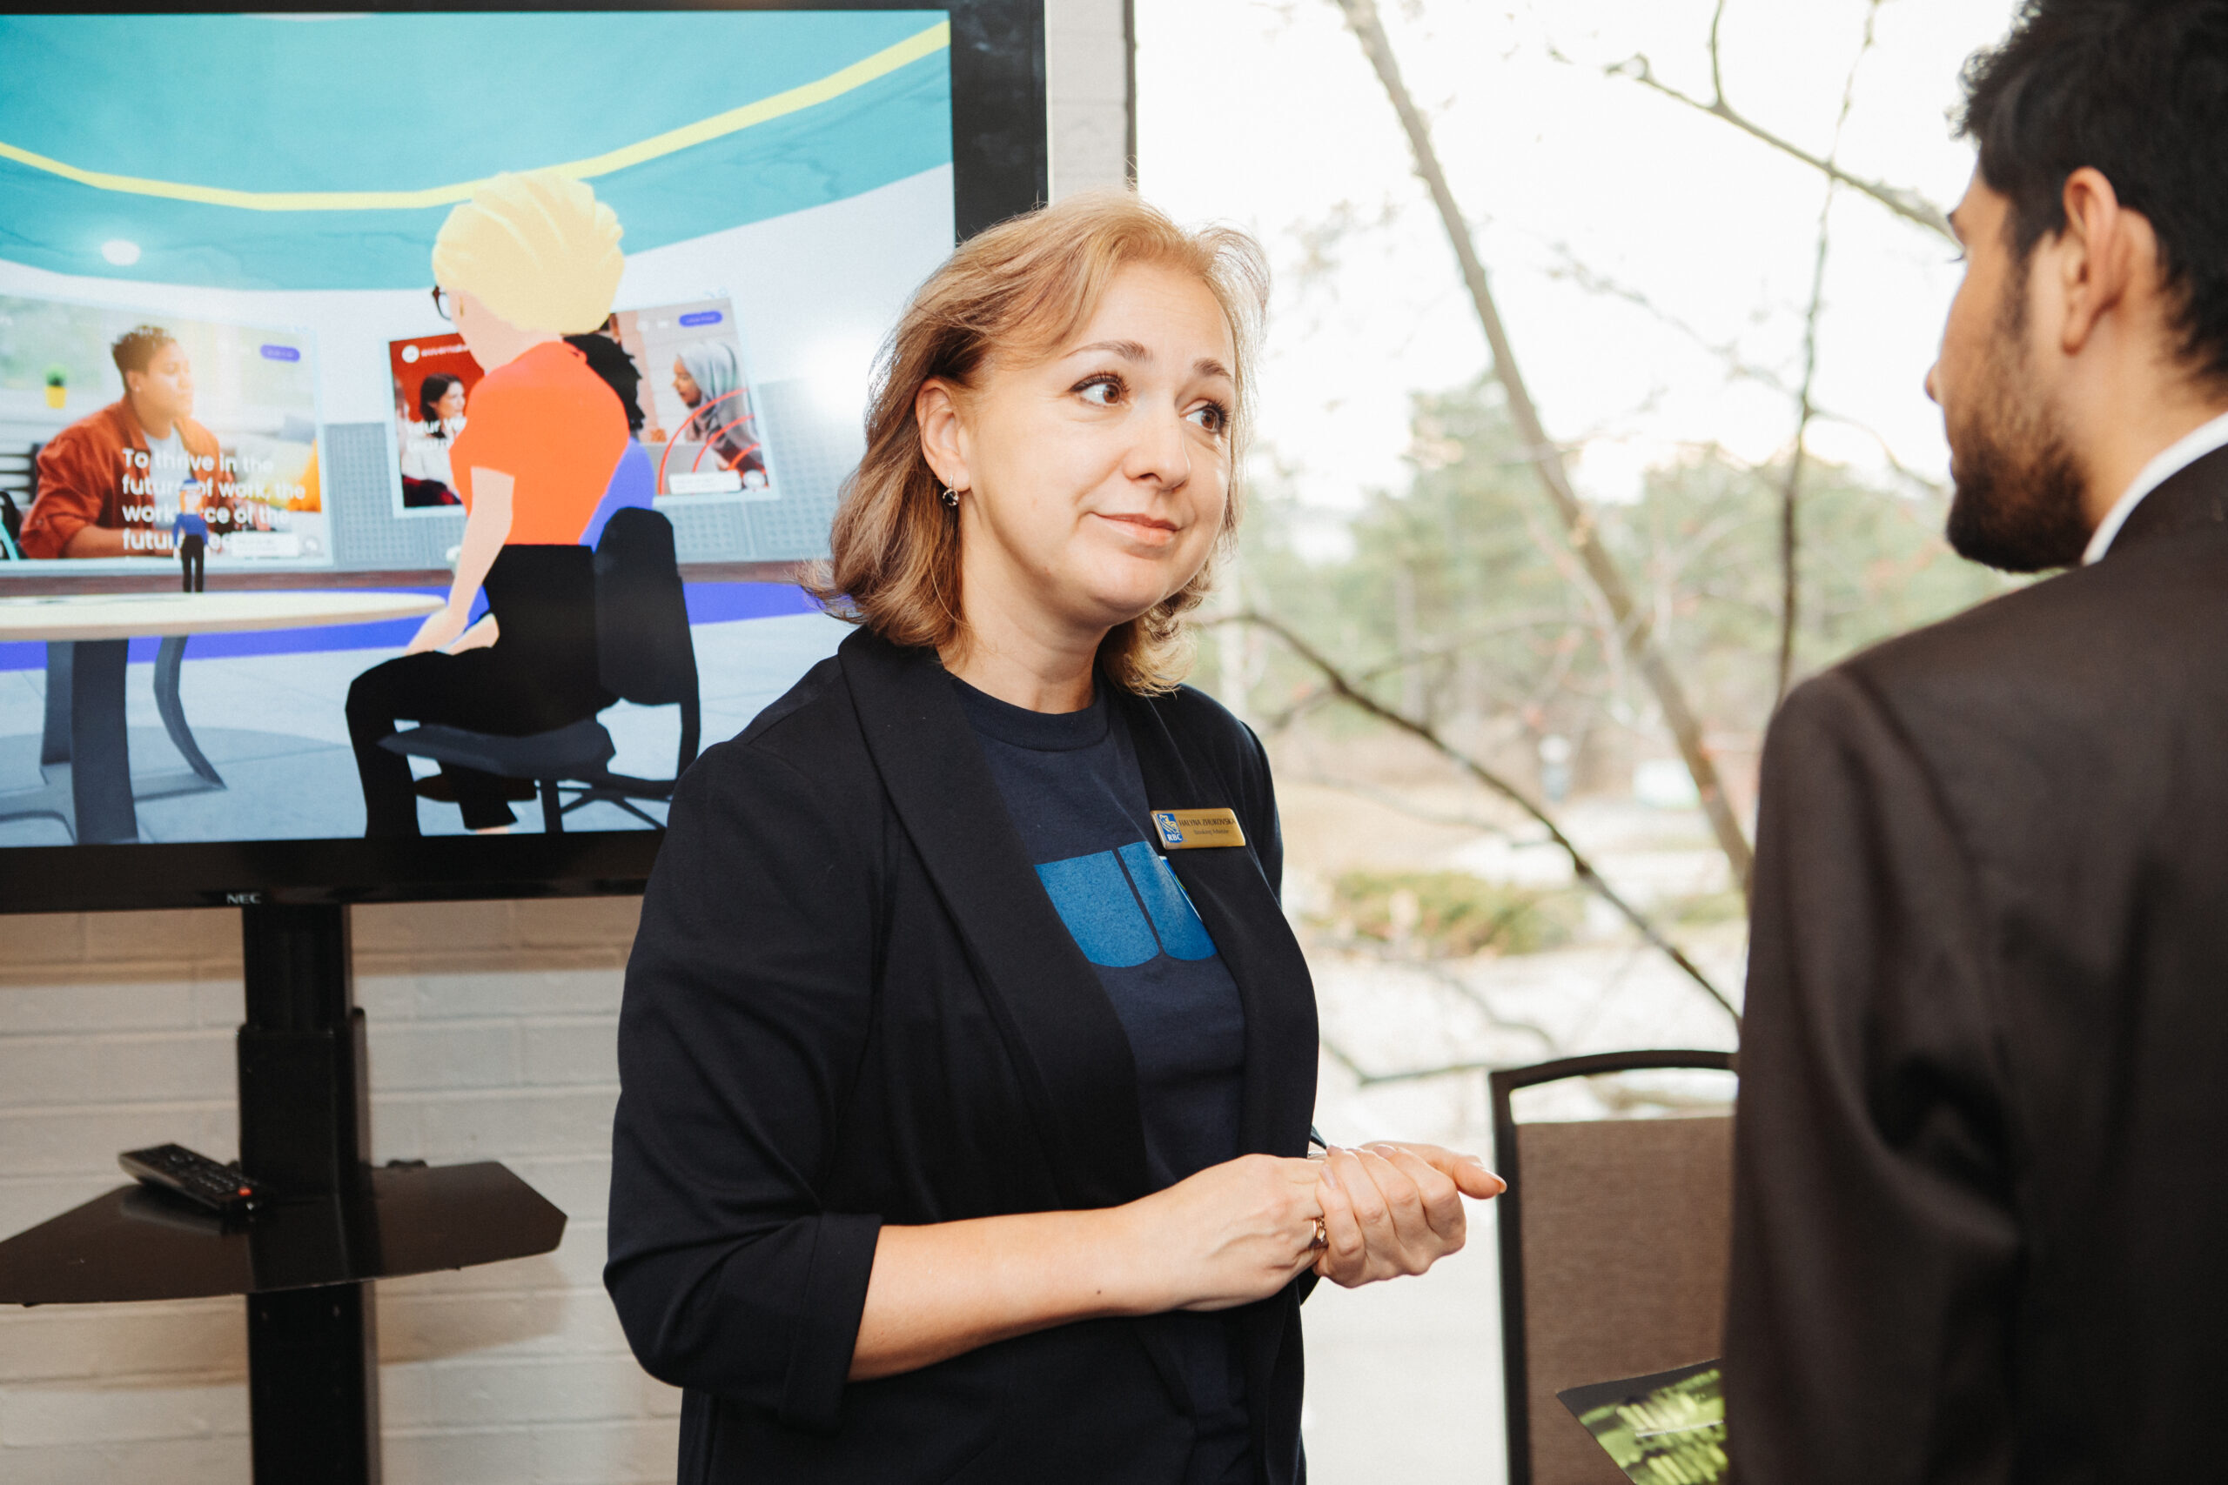
Enactus Career Connections
Enactus Career Connections, powered by RBC Foundation,
A mentorship program that connects ambitious students with experienced professionals
Key Benefits:
  Personalized guidance from industry professionals
  Support in career exploration, goal setting, and confidence-building
  A valuable addition to your Enactus and professional journey
Notes:
Eric

Slide 38
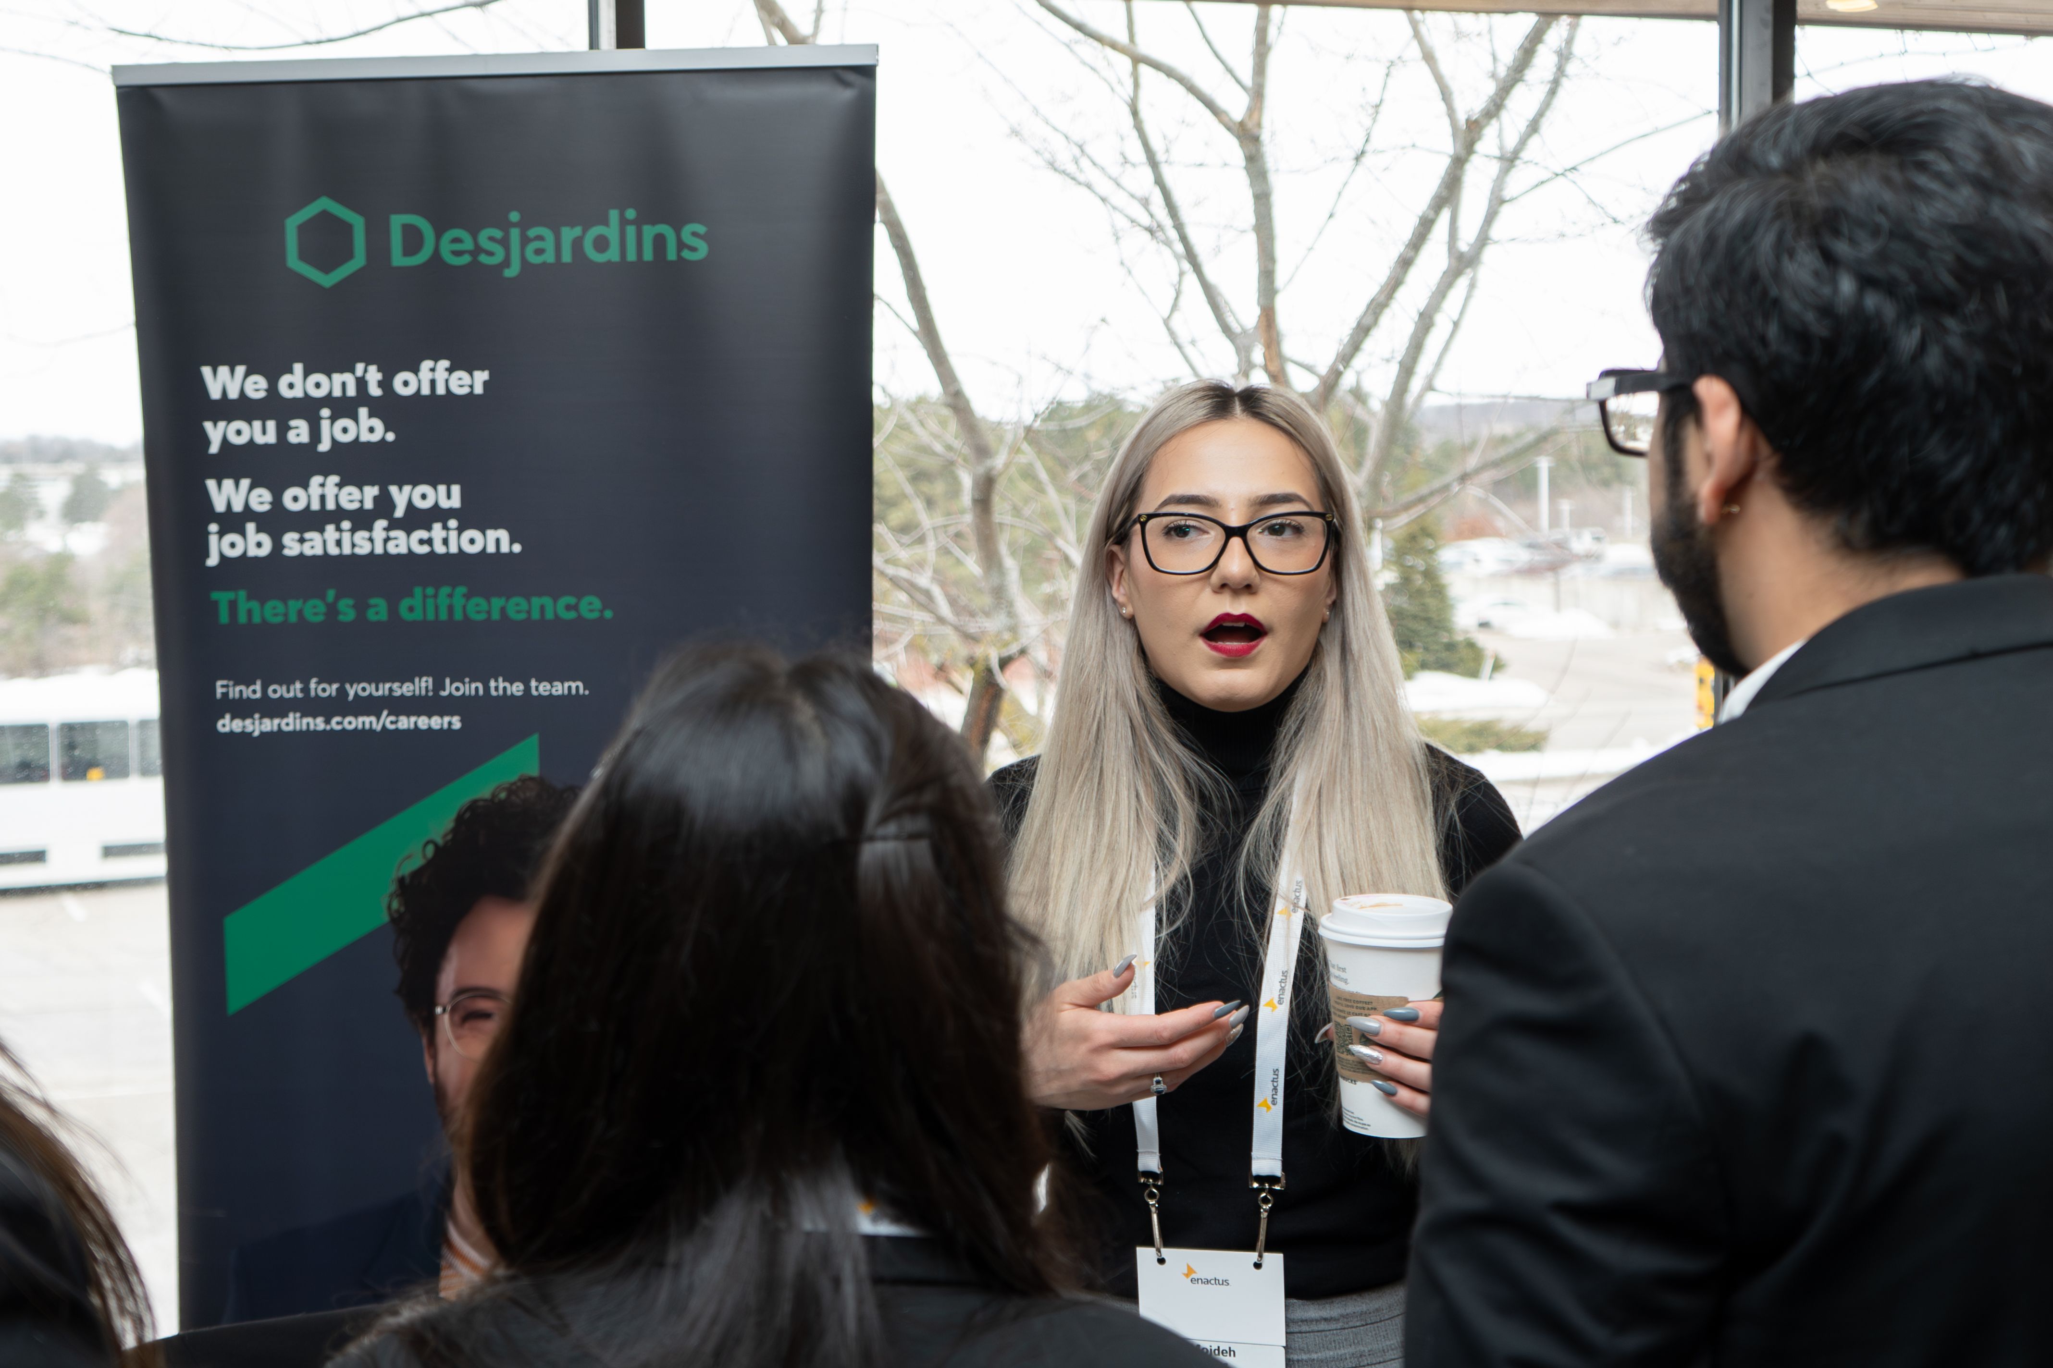
Enactus Career Connections
Duration: 6 months
Commitment: 3 meetings (student-led), flexible scheduling
Matching Process: Based on area of study, preferred sector, geographical location, and language
Launch Date: TBA
Notes:
Eric

Slide 39
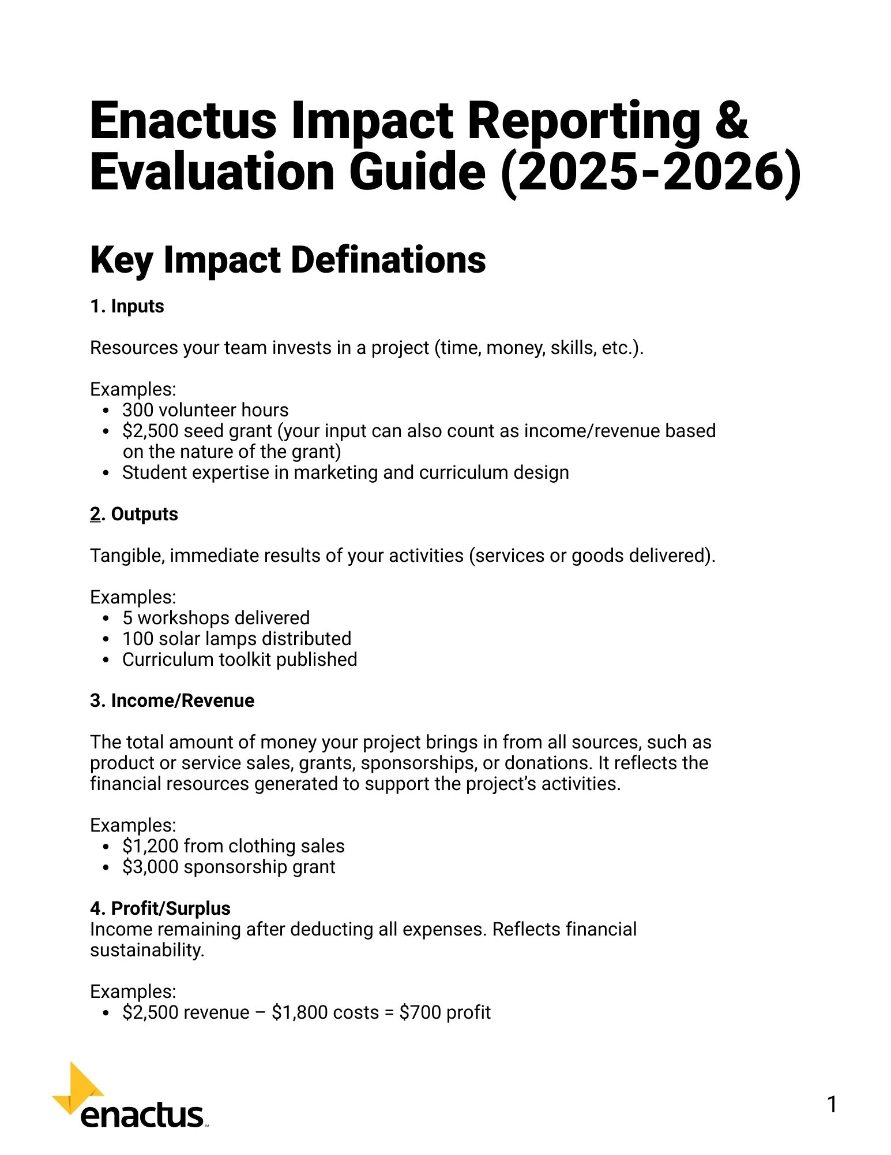

Data Collection & Reporting
Impact Reporting Guide
Available under Resources: Enactus Global definitions, impact calculation (direct/indirect) for both service and product, data collection & verification.
Ex. Customer reached and Customer acquired.
Notes:
Sohaib

Slide 40

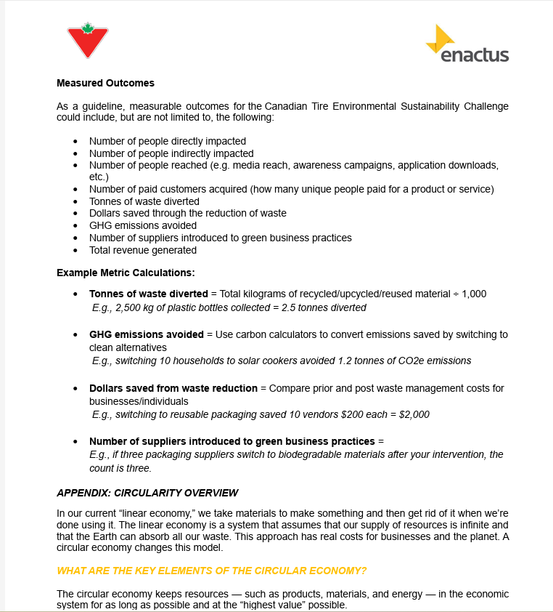
Data Collection & Reporting
Impact Challenges
Updated Impact Challenges Overview (with data points & calculation examples) now available under Resources
Notes:
Sohaib

Slide 41

Data Collection & Reporting
Standardized Annual Report
Standardized Annual Report (aligned with Enactus Global) coming mid-September.
Note: Your PM will be reviewing impact tracking with you in October. We want to ensure you're aligned with Enactus Global and ready for reporting and avoid scrambling later in the year.
Notes:
Sohaib

Slide 42
THANK YOU ☺
Notes:
all

Slide 43
Any Questions?
Notes:
all

Slide 44
Notes:
Maddie to start it off

